Slide 1

REFLEXION AND TRAINING STRATEGIC SEMINAR
FOR MANAGERS AND PROFESSIONA OF PHYSICLA REHABILITATION CENTRES ORGANIZED BY « OADCPH »
HOTEL EL MOURADI ND TUNIS ORTHOPEDIC REHABILITATION CENTRE,
FROM 15 TO 17 NOV 2019
GOOD PRACTICES IN MANAGING ORTHO-KINE SERVICES (OKS) CENTRE - BURUNDI
BY MR FERDINAND NDAYIZIGIYE
DIRECTOR FO THE CENTRE ORTHO-KINE SERVICES (OKS)

Slide 2

Introduction Plan
Introduction;
Presentation of the centre Ortho-Kine Services;
Organizational Chart of the centre;
Management tools set up.

Slide 3
I. Introduction
It is said somewhere in the depths of black Africa that "Man is the remedy of Man". This proverb that opens the door to solutions of the human being towards his neighbor, leads us to understand and live the importance of the action of assistance and mutual aid which is at the basis of what we share and have in common, namely the world of orthopedics in all its components.
I free myself from partisan feelings to bring the voices of all those who would like to understand the action of these orthopedic technologists scattered around the world to become "remedies of the man”. Remedies in action, through the sharing of information through training, but also and especially through the various actions related to improving the living conditions of people with disabilities around the world.

Slide 4
I realized, certainly as many of you, the great interest that orthopedic technologists place on the satisfaction of patients' needs. From attention to action through listening, counseling and support, the target has always been the person with disability for whom solutions are sought, means are implemented, scientific knowledge are deployed, and technical aids provided. As an actor in this dynamic through Ortho-Kine Services (OKS), I think I can be in a position to tell the recognition of these people with disabilities with respect to orthopedic technologists, but also and above all hope that they put on the actions undertaken by the various bodies of orthopedics to improve their living conditions. SiIf our credo is to work so that "living with an impairment is no longer a disability", we are well aware that the objectives are far from being achieved but hope is strongly allowed.

Slide 5
II. Presentation and Reference of the centre Ortho-Kine Services

Slide 6
II.1. Presentation of the centre Ortho-Kine Services
The Centre Ortho-Kine Services is an orthopedic and physiotherapy company created in 2006 at the initiative of Mr. Ferdinand NDAYIZIGIYE and approved by ordinance n ° 724 / CAB / 09 of 09 April 2009 of the Ministry of Public Health of the Republic of Burundi.
Ortho-Kine Services is member of FATO and OADCPH.
It was created for the unique purpose of providing quality rehabilitation and functional rehabilitation care for the national and sub-regional population (RWANDA, DRC), with the support of orthopedic technologists and physiotherapists trained in medical international schools.

Slide 7
Ortho-Kine Services comprises the five (5) following services:
Orthopedic fitting service;
Physiotherapy and functional rehabilitation service;
Comfort physiotherapy service;
Sale and rental of assistive walking device service;
Training service.

Slide 8
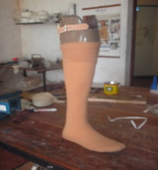
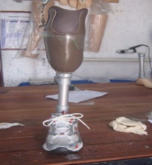
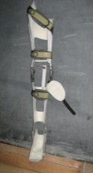
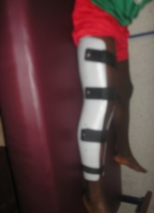
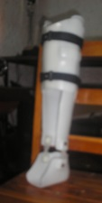
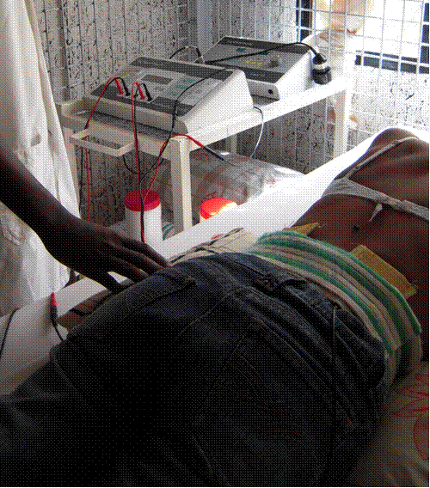
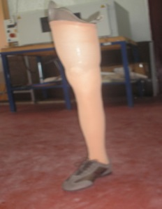
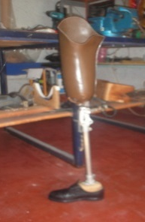
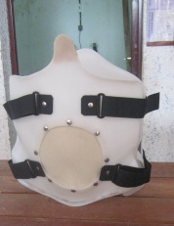
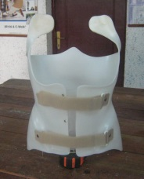
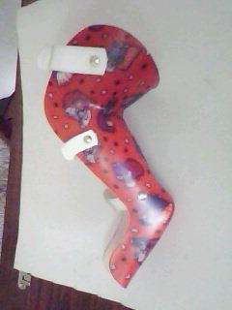
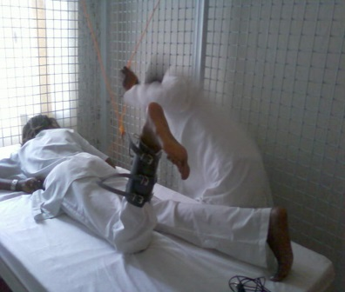
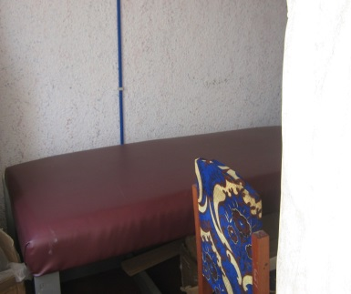
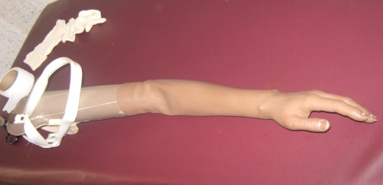
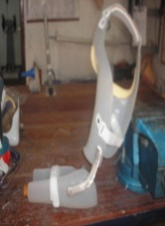
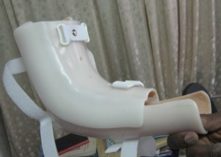
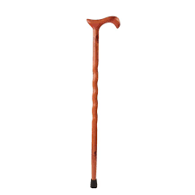
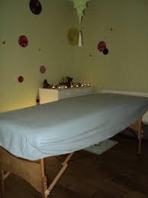
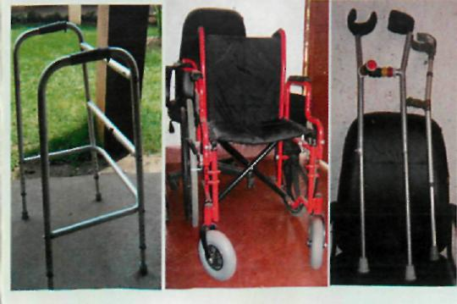
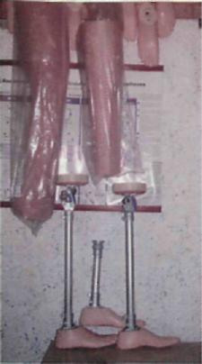
Orthopedic fitting service: - Manufacture of prostheses; - Manufacture of gait orthoses and different kinds of splint; etc.
Physiotherapy and functional rehabilitation service:
- Consultation room
- Physiotherapy room
- Electrotherapy devices
Comfort physiotherapy service: Massage and Sauna
Sale and rental of assistive
walking devices service;

Slide 9
III. Organizational Chart of the centre
Director
Secretariat
Physiotherapy service Manager
Orthopedic fitting service Manager
Administrative and Financial Manager
Accounting Officer
Physiotherapists
Orthopedic Technologists and Assistants
Purchasing Officer
Casher
Masseuses
Communication
And stocks mangement Officer
Maintenance staff
SUPPORT TEAM
Driver, liaison officer
Housekeeping
Sécurity

Slide 10
IV. Mangement tools
Chart of accounts
Fixed-asset sheet;
Stock card;
Store entry slip;
Board of Directors decisions’ monitoring Chart;
Leave application Form;
Planning and monitoring annula leaves;
Vehicles logbook;
Vehicle repair application form;
Record of fuel consumption.
Etc.

Slide 11
Fixed-asset sheet
Order N° | Description/ Model | Acquisition date | Serial N° | Uer or location | Code | Conditoon | Acquisition value

Slide 12
Stock card
ARTICLE DESIGNATION :
QUANTITY : COUNTING UNIT:
Date | ENTRY |  |  | WITHDRAWAL |  |  | FIANL STOCK
 | Quantity | UP | TP | Quantity | UP | TP | Quantity | UP | TP

Slide 13
Store entry slip n°......
Purchase request form n° :
Purchase order n° :
Acceptance report :
Supplier :
Fbu amount :
Imputation :
CATEGORY | ARTICLE DESCRIPTION DE L’ARTICLE | UNIT | QUANTITY | UNITARY PRICE | TOTAL PRICE FBU
TOTAL
SENDER STOCK CARRIER MANAGER
Date & signature Date & signature Date & signature

Slide 14
Board of Directors decisions’ monitoring Chart
ORDER N° | DATE OF MEETING | MAJOR DECISIONS/RE COMMENDATIONS | SERVICE RESPONSIBLE FOR IMPLEMENTATION | STATUTE: (IN PROGRESS, REJECTED, COMPLETED) | DOCUMENT/REFERENCE OF VERIFICATION

Slide 15
Leave application form
Surname and first name of
Executive/Agent………………………………………………………………………………………
Reason for leave……………………………………………………………………… ………………...........
Start date of leave…………………………………………………………………………
End date of leave……………………………………………………………………………..
Number of days requested…………………………………………………………..
Number of remaining days……………………………………………………………..
Signature of the Executive/Agent……………………………………………………………………….
c/o direct Manager (name, date and signature)…………………………………………………………………………………………………………………
Checked by AFM (name, date, signature)……………………………………………………………………………………………………………………
Authorized by the Director or his Delegate (name, date, signature)…………………………………………………………………………………………………………………………………………………………………………………………………………………………………………………………………………………………

Slide 16
Planning and monitoring of annual leaves
SURNAME AND FIRST NAME | SERVICES | PERIOD SCHEDULED | NUMBER OF SCHEDULED DAYS | NUMBER OF DAYS REQUESTED | NUMBER OF REMAINING DAYS | OBSERVATIONS

Slide 17
Fixed-asset sheet
Order N° | Description/ Model | Acquisition date | Serial N° | Uer or location | Code | Situation | Acquisition value

Slide 18
Vehicles log book
Vehicle Brand : Type : License plate N° : Name of the driver:
Date | Departure time | Destination | Return time | Km at departure | Km on arrival | Km made | Purchased fuel | Observation

Slide 19
Vehicle repair request form
DATE :
VEHICULE : BRAND :
LICENSE PLATE :
USER :
PROBLEMS DETECTED ON THE VEHICLE
________________________________________________________________________________________________________________________________________________________________________________________________________________________________________________________________________________________________________________________________________________________________________________________________
REQUESTED BY: C/O USER :
NAME OF THE DRIVER : NAME :
SIGNATURE : SIGNATURE :
FOR CHECKING : FOR APPROVAL:
AFM Director

Slide 20
Fuel consumption report
DATE | PLATE | INDEX | Qty CONSUMED | TYPE (GAZOIL/GASOLINE | OBSERVATION

Slide 21
THANK YOU FOR YOUR ATTENTION

