Slide 1

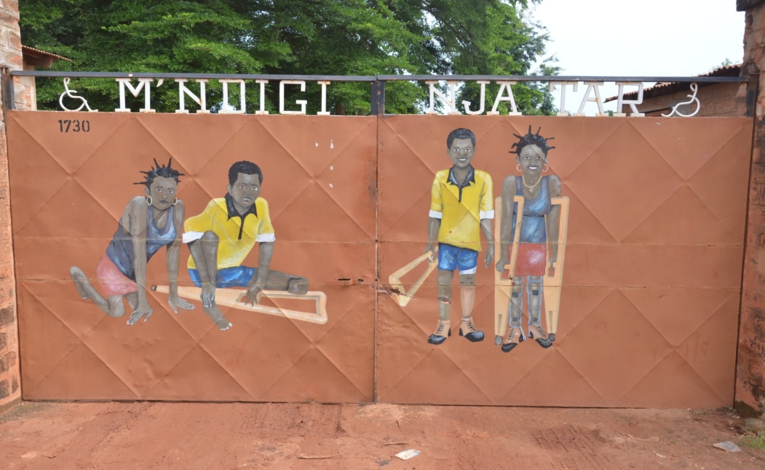
Maison Notre Dame de Paix (MNDP)
Functional rehabilitation and social inclusion Centre

Slide 2
Introduction
Tchadian Association
Created in 1979
Father Michel Guimbaud
Children strolling on their knees: sequelae of poliomyelitis
« M’Ndigi Nja Tar : I want to walk upright »
35000 patients supported
About 1500 patients per year
32 permanent professionals at the centre
Welcome capacité: 77 beds

Slide 3
Objectives of the centre
General objective:
Propose rehabilitation and health care in order to include people with disabilities in Tchadian society
Health care
Functional rehabilitation
Social aspect (schooling of children, training)
Our values :
Egality in care
Access to health care for all
Inclusion of vulnerable populations
Support to the poorest people
Education and training for empowerment
Notes:
Réadaptation fonctionnelle (rééducation, appreillage
Accès à tous aux soins de santé ( participation selon les capacités financières)

Slide 4
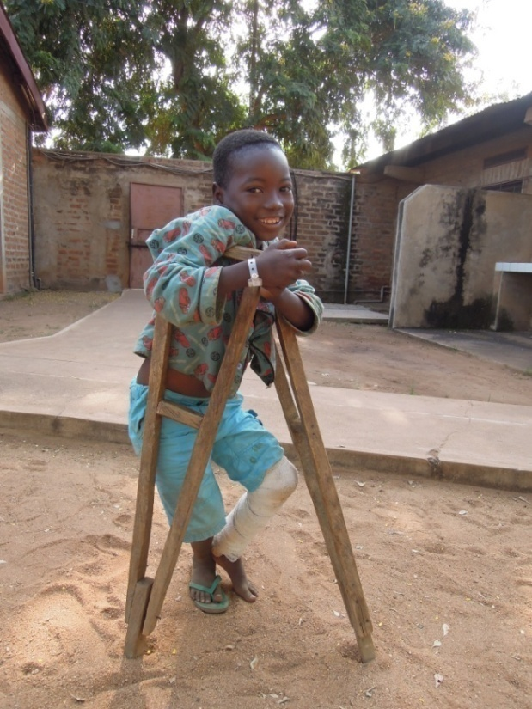
Treated pathologies
Treatment of all type of physical disability
Road accidents
Domestic accidents (burn with
retraction of limbs)
Congenital malformations (club feet)
Multiple Paralysies
Osteitis, ostéomyelitis
Stoke
Sequelae of poliomyelitis
Etc…
Notes:
1 seul centre au tchad !!!

Slide 5
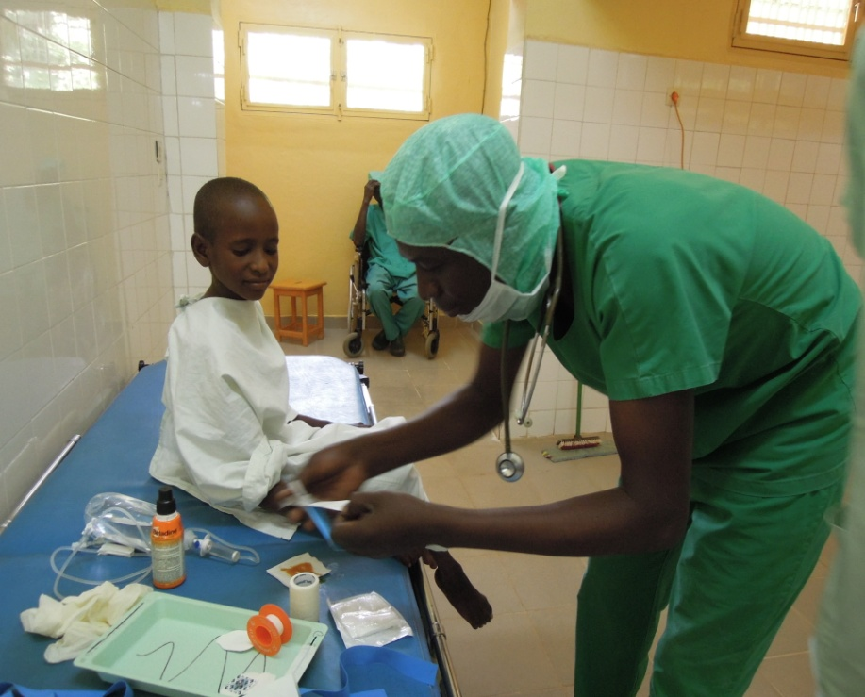
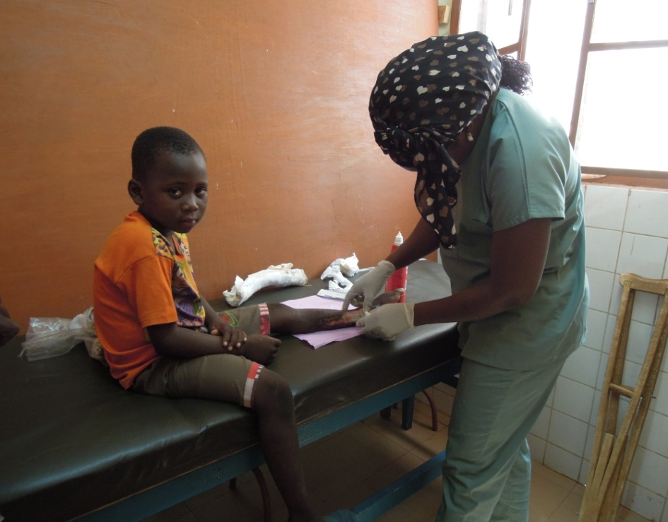
The nursing service
3 State graduated Nurses

Slide 6
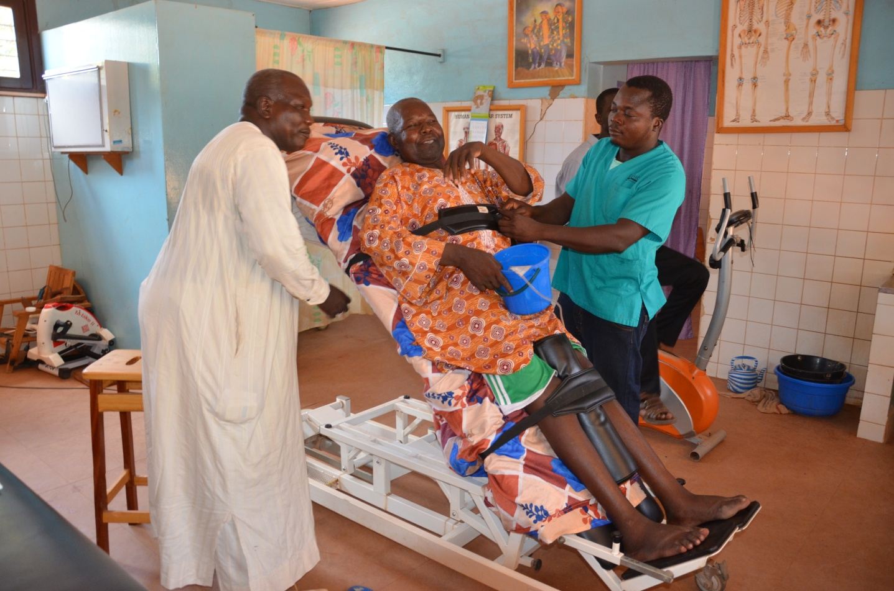
The Rehabilitation service
4 Physiotherapists
1 assistant physio

Slide 7
Physiotherapy ~ heal by movement and for movement
The Physiotherapist = a professional who performs reeducation and rehabilitation care in order to maintain or restore the patient's movement and functional abilities.

Slide 8
The physiotherapist plays a key role in the care of the patient from the initial phase in intensive care for:
- Neurological patholigies such as hémiplégia - Pre and post operative care of neurological
pathologies - Brachial plexus palsy - Congenital malformations such as club feet

Slide 9
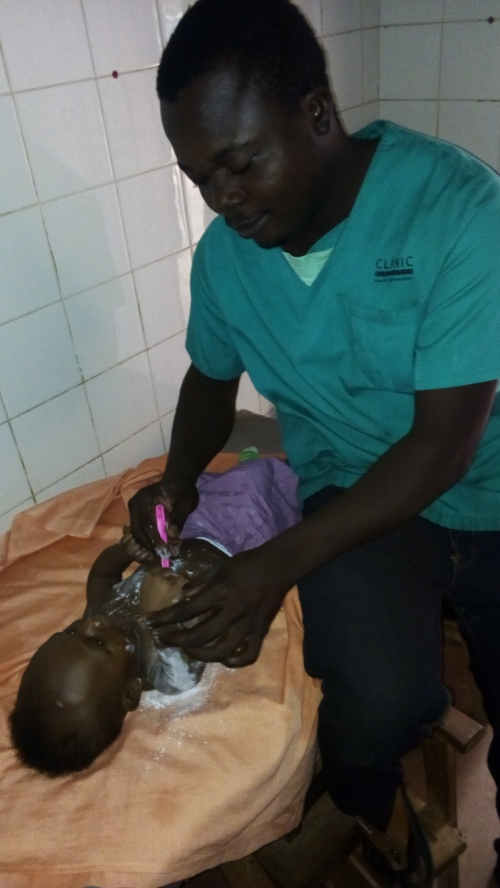
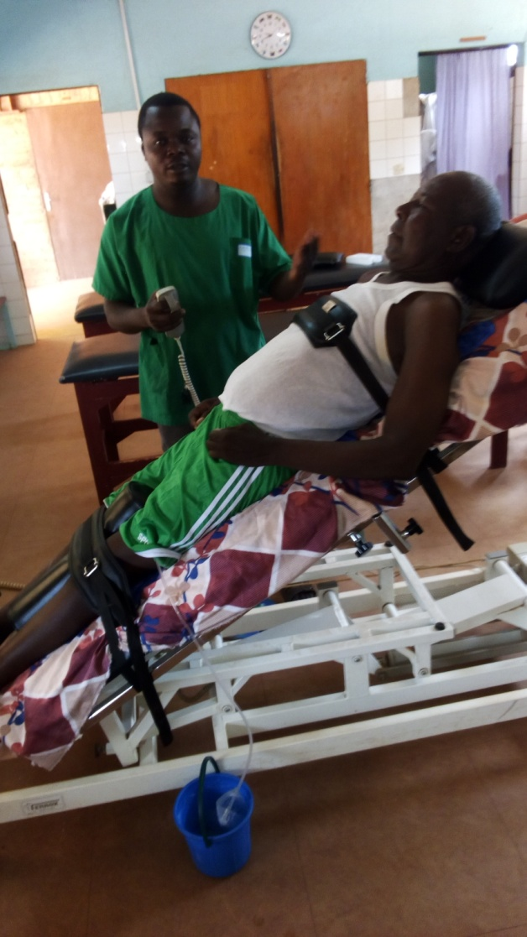
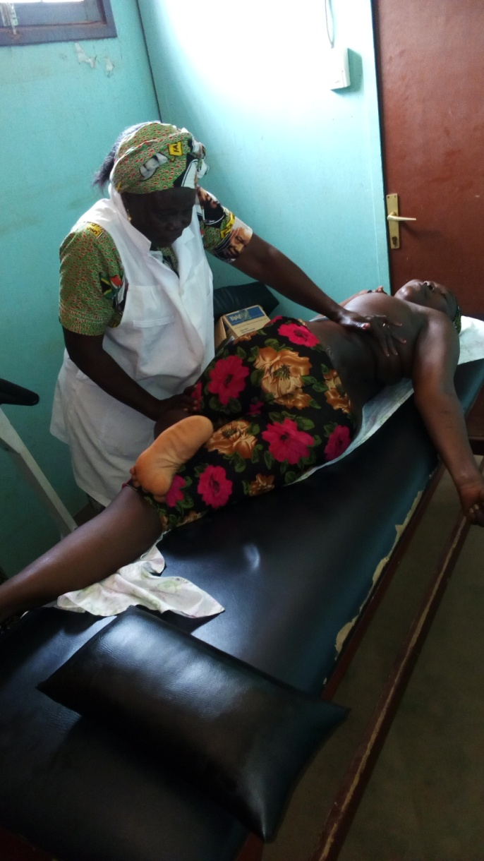
Some examples of support:

Slide 10
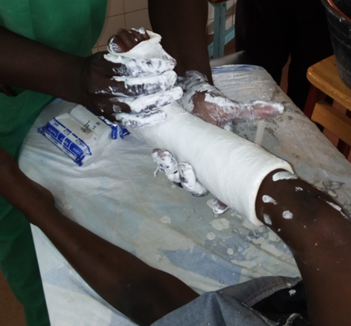
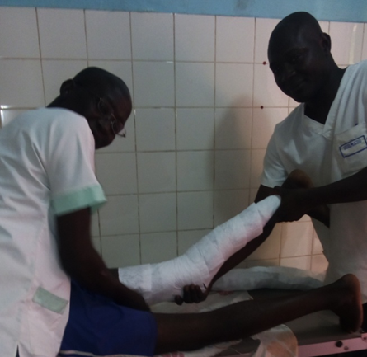
Relationship between physiotherapy and orthopaedics: Examples
Plastered Posture to correct the foot of a child born with a malformed foot
Preparation of an extension splint

Slide 11
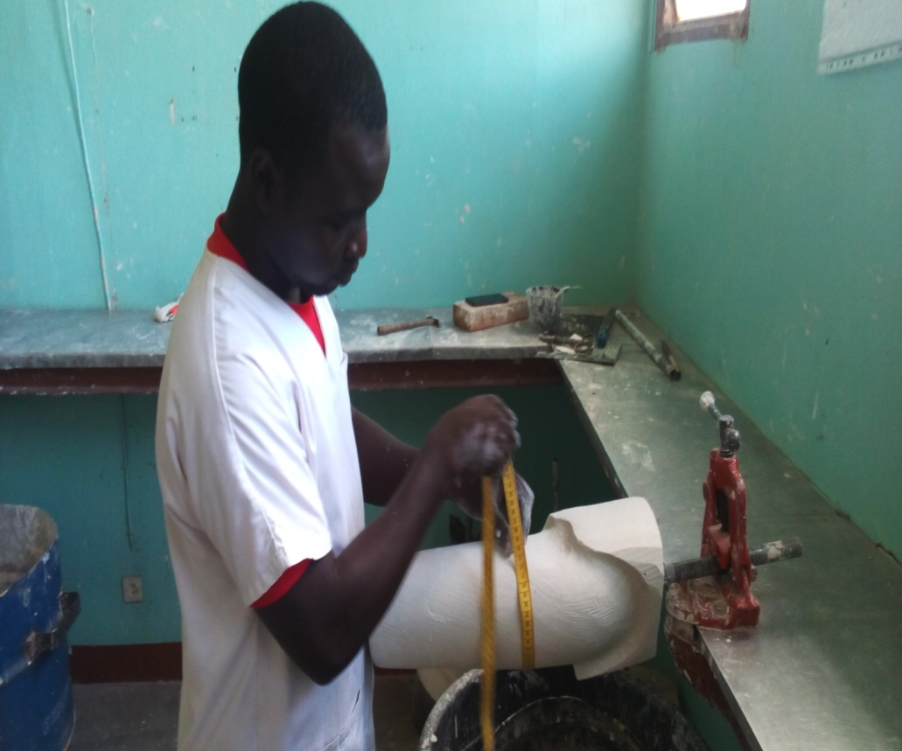
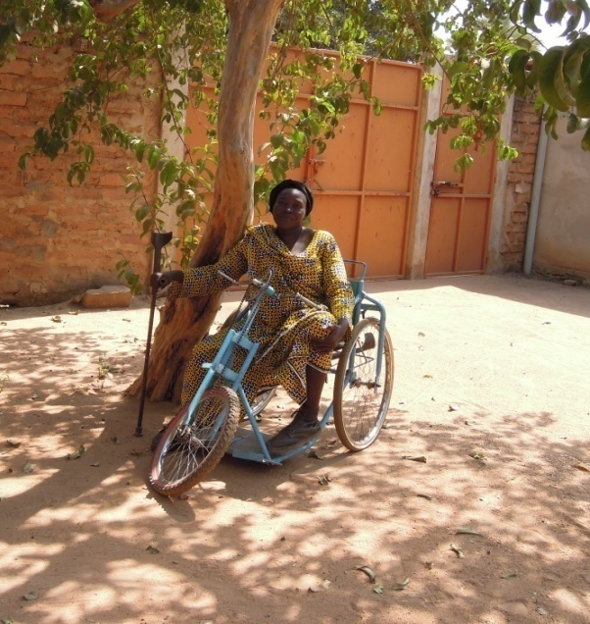
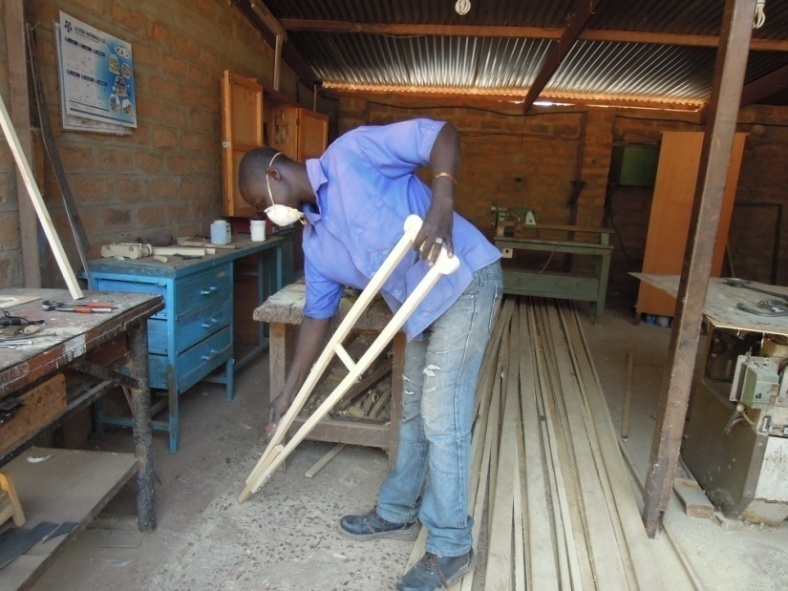
Orthopaedic fitting service
3 P&O Technologists
and 7 assistant P &O Technologists
1 carpenter
2 scrap dealers
Orthopaedic fitting section;
Mechanics section;
Carpentry section

Slide 12
Orthopaedics ~ Care thanks to orthopaedic fitting
P & O Technologists = a professional who performs care through prosthesis and orthosis in order to improve the posture and restore the functional abilities of the patient.

Slide 13
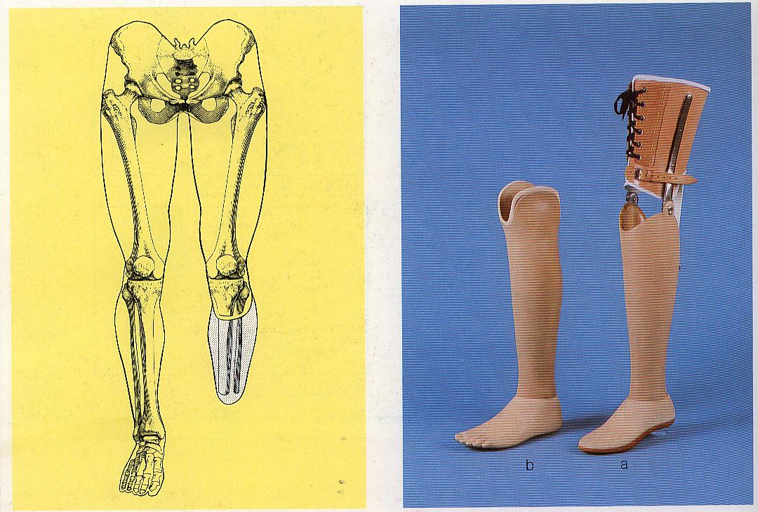
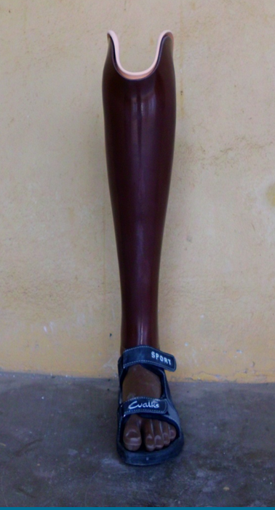
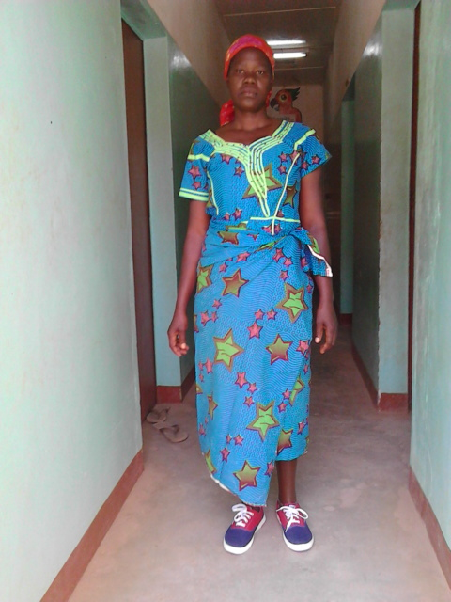
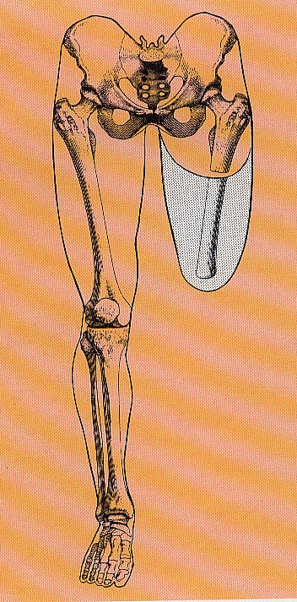
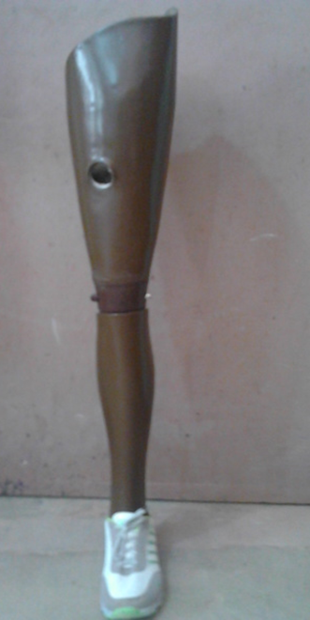
Orthopaedic fitting section
Prostheses

Slide 14
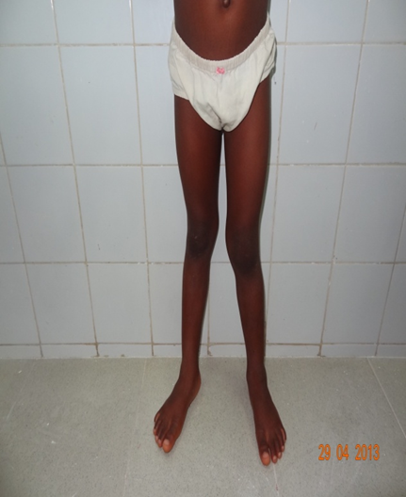
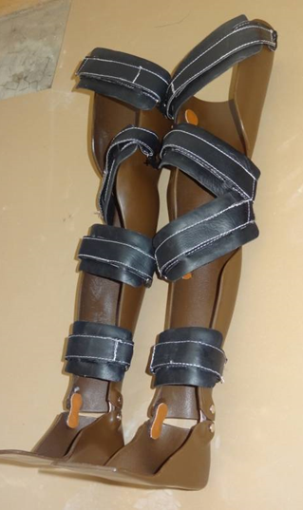
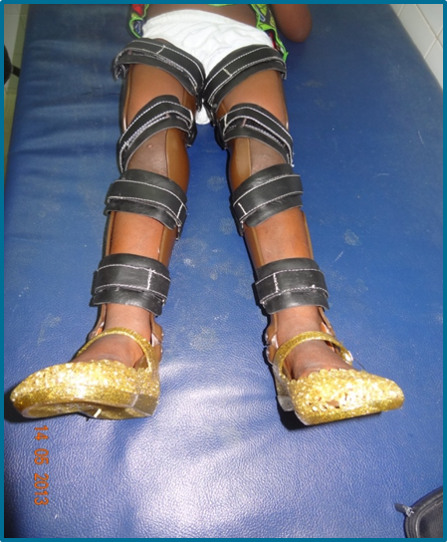
Orthopaedic fitting Section (continued)
Correction KAFO

Slide 15
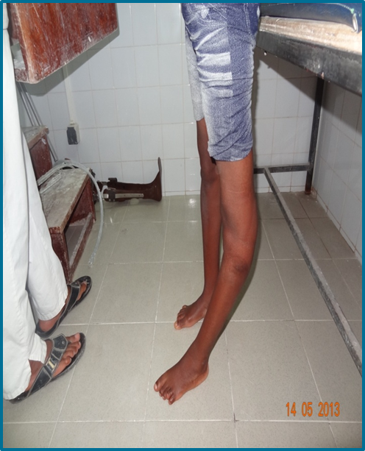
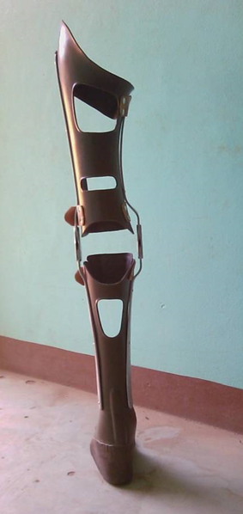
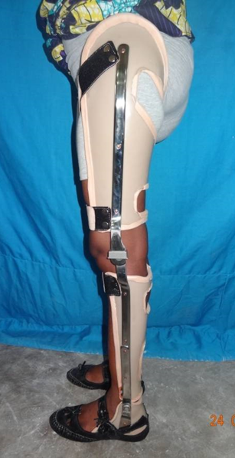
Orthopaedic fitting section(continued)
Dynamic KAFO orthoses

Slide 16
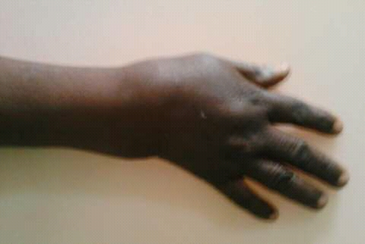
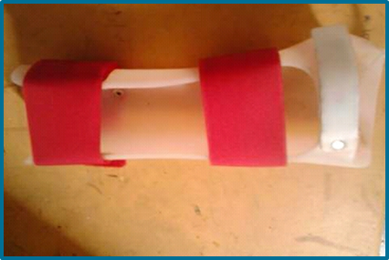
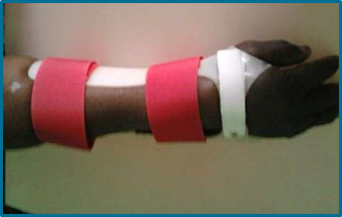
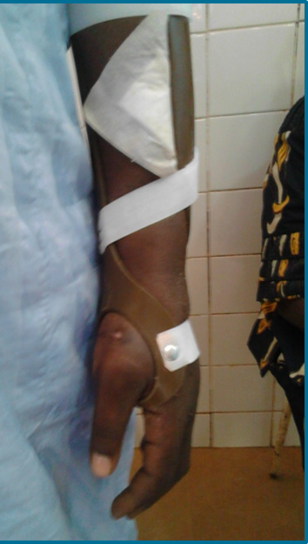
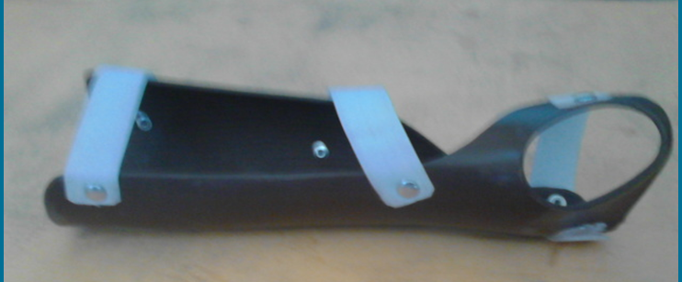
Orthopaedic fitting section (continued)
Wrist orthosis
Forearm and wrist orthosis

Slide 17
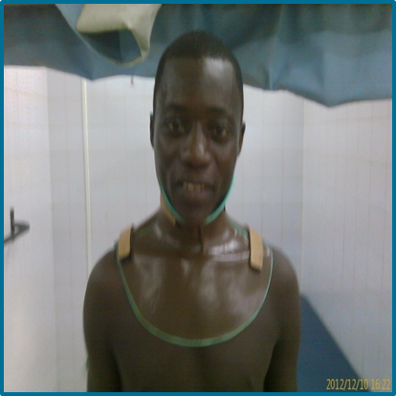
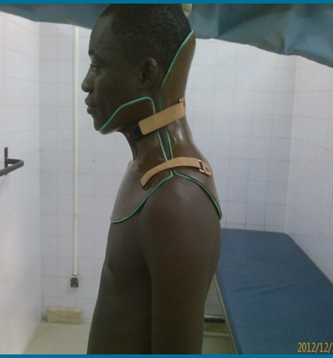
Orthopaedic fitting section (continued)
Neck orthosis (arthrosis, pain, accident)

Slide 18
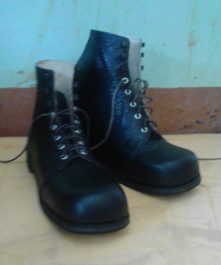
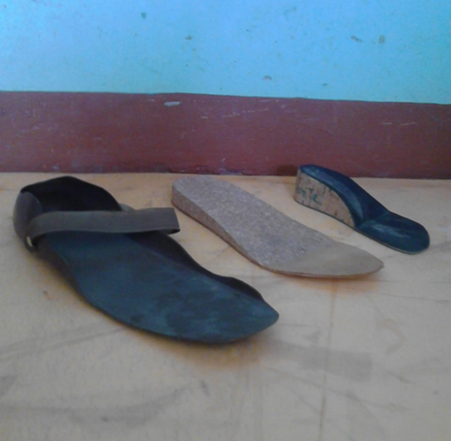
Orthopaedic fitting(continued)
Orthopaedic shoe or insole

Slide 19
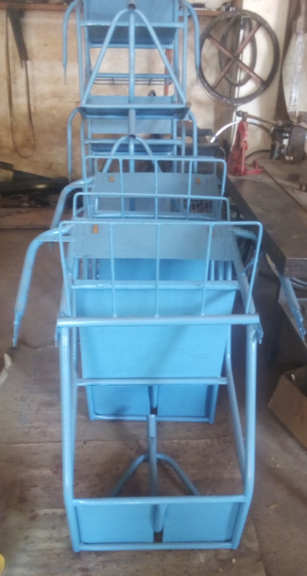
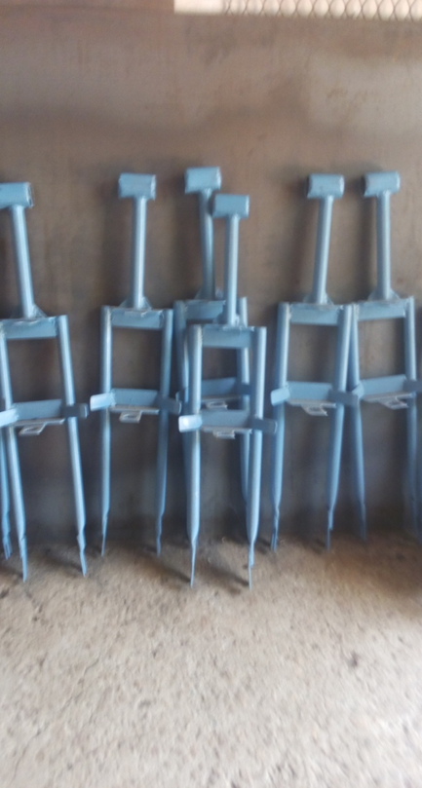
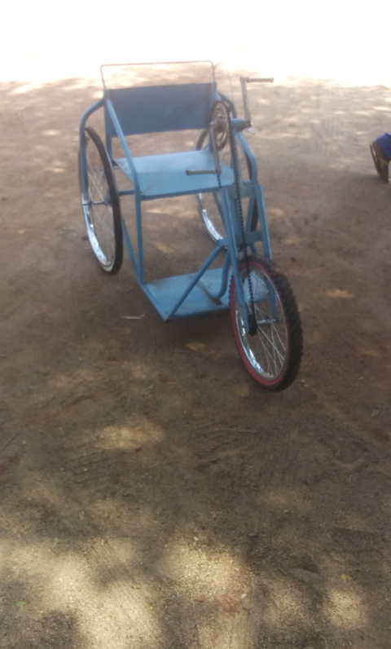
Mechanics section

Slide 20
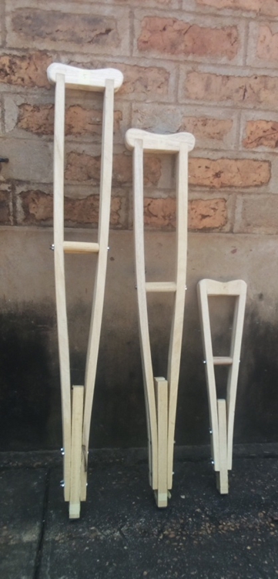
Carpentry section

Slide 21


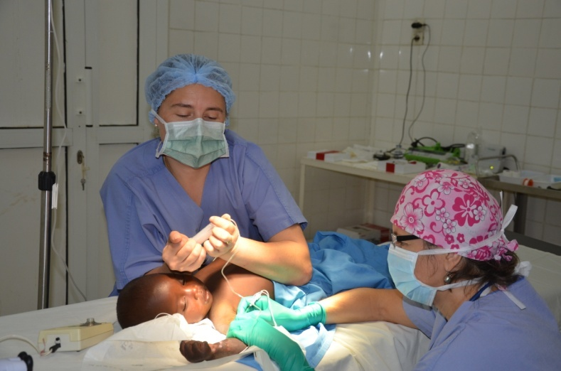
Surgical missions
Partnership with Handicap Santé (HS)
4 times a year (200 operated persons/year)
Plasty – Orthopaedics
Partnership with Action Santé Femmes (ASF)
2 times a year
Obstetric fistula

Slide 22
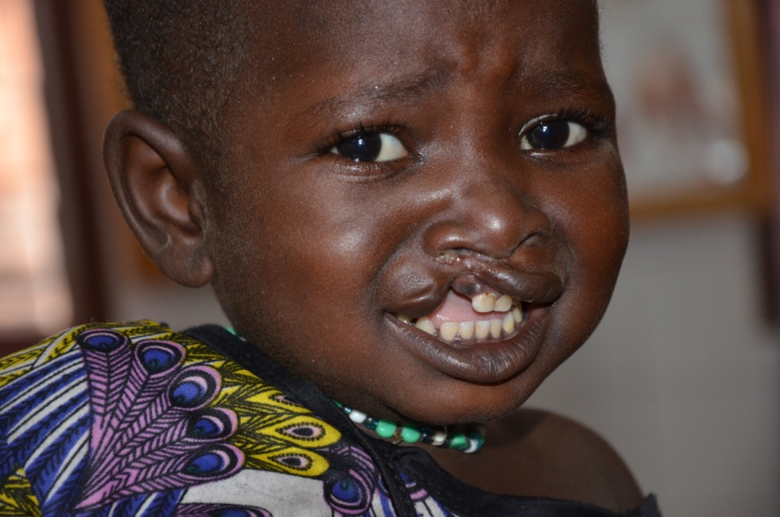
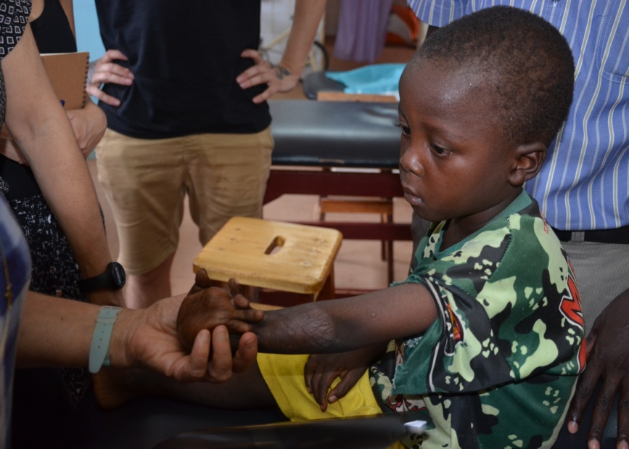
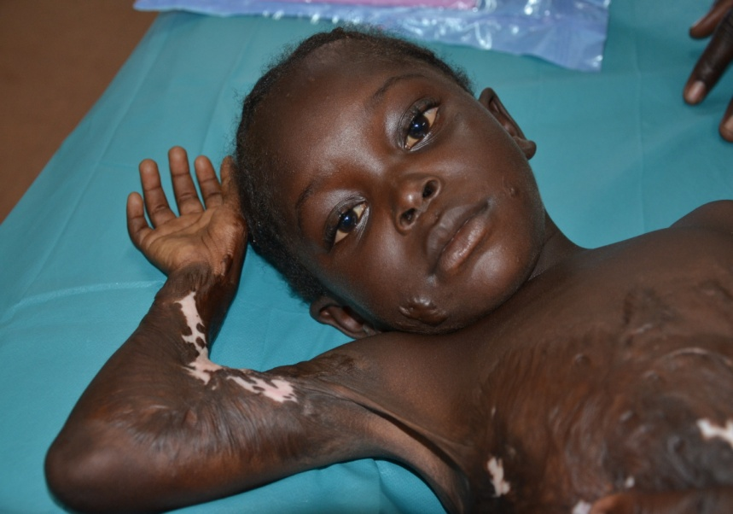
=> Plasty mission

Slide 23
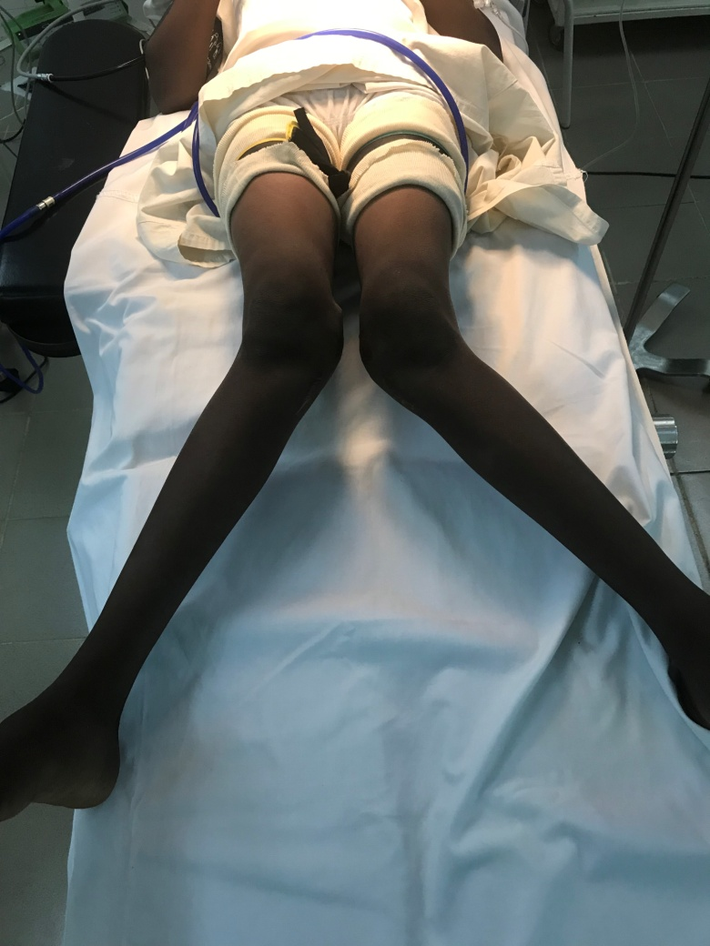
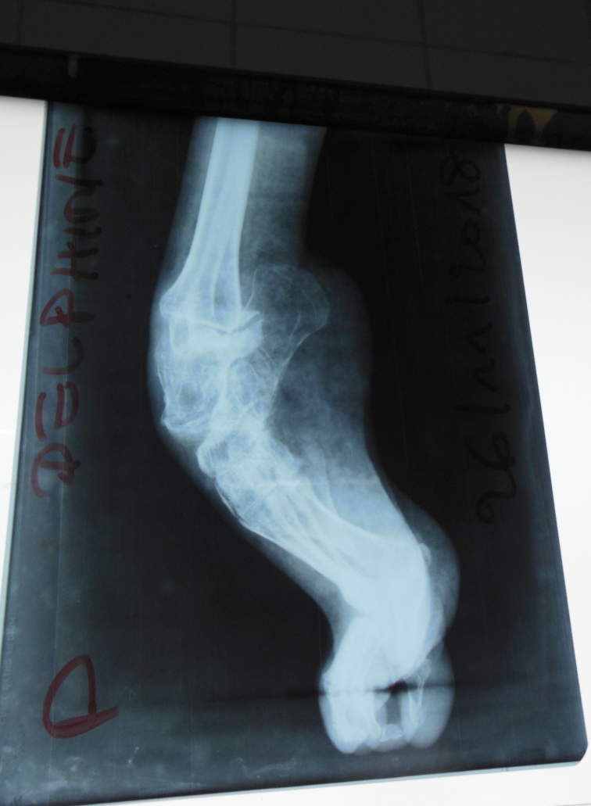
=>Orthopaedics mission

Slide 24
Encountered difficulties
Few communication and data sharing between rehabilitation and health
Lack of early detection or late referral to rehabilitation centres
Public misunderstanding of rehabilitation
Insufficient P&O technologists in rehabilitation and absence of certain jobs
Inadequate rehabilitation structures at national level
Low involvement of authorities in rehabilitation sector

Slide 25
Centres of Doba, Laï
Functional rehabilitation
Social inclusion of adolescents with disabilities

