Slide 1
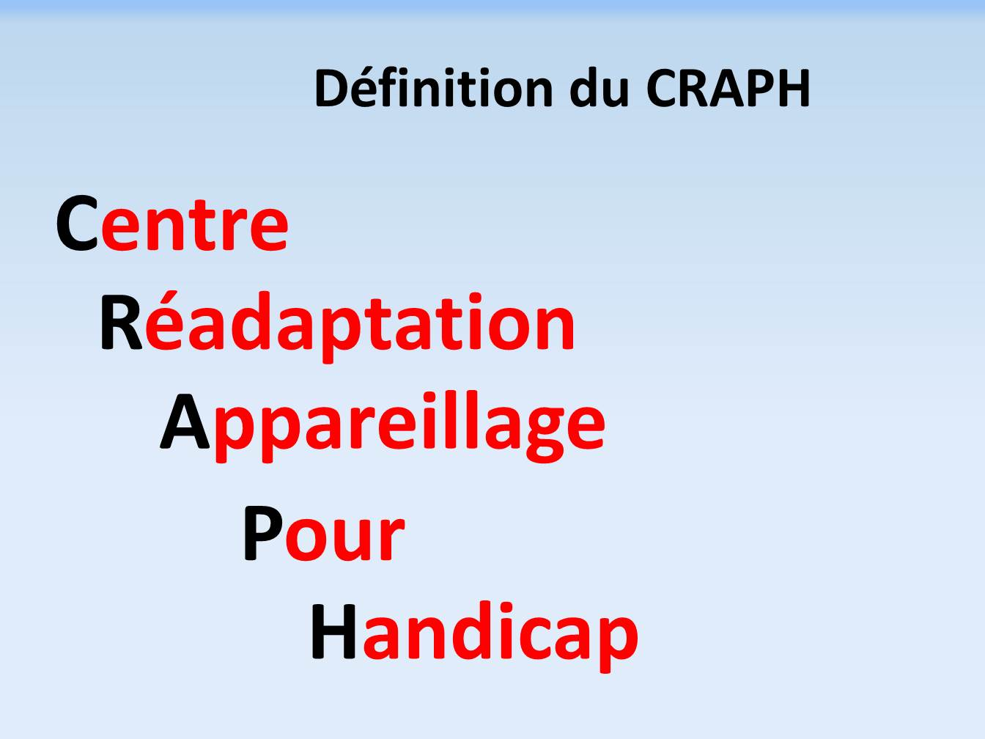

THE REASON TO LIVE – THE RIGHT TO HOPE

Slide 2
CREATION
CRAPH 27 March 2009
VISION
Give joy to people with disabilities;
Restore Human Dignity
PASSION
Meet my father’s challenge
COMMITMENT

Slide 3
INTRODUCTION
Gabon, like all other developing countries, has huge problems.
In health field, as far as people with disabilities are concernerd, despite the tireless efforts of the government, much remains to be done.
Several surveys reveal a significant rate of disabilities throughout the national territory, so it is true that many children are born, grow up and die with their disability after a family, school, social and professional painful life.

Slide 4
GEOGRAPHIC LOCATION
Gabon is a country of Central Africa, which is bathed by the Atlantic Ocean. It has 800 km of coast, and is crossed by the Equator. It is limited at the North by Equatorial Guinea, Cameroon and at the South East by Congo.
The country is full of many important riches such as oil, uranium, manganese, iron, lead, silver among others…..
It has one of the highest per capita incomes in Black Africa.
Its population is 1 587 685 inhabitants with a surface of 267 667 km2.
Gabon’s capital is Libreville, wih 700 000 inhabitants. The official language is French and its currency is CFA.
The Gabonese Republic is divided into nine(09) provinces, each under the authority of a governor. The nine (09) provinces and their administrative centres are:
Estuary (Administrative centre Libreville) ;
High-Ogooue (Administrative centre Franceville) ;
Middle Ogooue ( Lambaréné) ;
Ngounié (Mouila);
Nyanga (Tchibanga) ;
Maritime Ogooue (Port- Gentil) ;
Ogooue Ivindo (Makokou) ;
Ogooue Lolo (Koulamoutou) ;
Woleu-Ntem (Oyem)

Slide 5
CORRECTED CENSUS DATA ON PEOPLE WITH DISABILITIES (October 1997) ORGANIZED BY THE DEPARTMENT SOCIAL AFFAIRS
PROVINCES | New data after verification | Men (%) | Women (%)
ESTUARY | 3243 /100% | 1739 /54% | 1504 /46 %
HIGH - OGOOUE | 749 /100% | 399 / 53% | 349 /47%
MIDDLE- OGOOUE | 790 /99% | 382 / 52% | 408 /47%
NGOUNIE | 1038 /100% | 346 /33% | 692 /67%
NYANGA | 981 /100% | 514 /52% | 467 /48%
OGOOUE-IVINDO | 776 /100% | 404 /52% | 372 /48%
OGOOUE-LOLO | 808 / 100% | 428 /53% | 380 /47%
MARITME OGOOUE | 546 / 100% | 284 /52% | 262 /48%
WOLEU-NTEM | 1232 /100% | 632 /51% | 262 /49%
TOTAL | 10162 /96% | 4828 /47% | 5034 /49%
Notes: In Gabon, the number of women with disabilities is higher than that of men.
More than a third (1/3) of people with disabilities live in the Estuary province.

Slide 6
GOALS AND OBJECTIVES
IMPROVE the physical, locomotor and moral health of people with disabilities
OBJECTIVES
MANUFACTURING of orthopaedic devices;
IMPORTING OF orthopedic components and assistive devices
(wheelchairs, canes, tricycles, …);
SENSITIZATION of peoples with disabilities families in the community;
ENSURE the monitioring of fitted persons;
PROVIDE people with disabilities with appropriate technical aids;
NEGOCIATE direct payments in the care of patients in need;
MAINTAIN relationship with firms and humanitarian associations working in the care for people with disabilities;
PROMOTE people with disabilities through sport, music, etc…
ENSURE TRAINING for the technical staff

Slide 7
MISSION OF THE ORTHOPEDIC AND REHABILITATION CENTRE
The mission of the centre is:
To administer preventive, curative and rehabilitative treatments to people with impairments or disabilities;
To allow any person with disabilty to resume his/her daily activities.

Slide 8
The different services
The device production department, in charge of making orthopedic devices to maintain, correct or replace a part of the body (orthosis prosthesis), insoles,).
The community-based rehabilitation and physiotherapy service responsible for massage, pre- and post-operative rehabilitation, muscle building, electrotherapy, functional rehabilitation, etc.
Speech Therapy and hearing services to prevent, assess and treat people who have difficulty hearing or speaking,
Chaplaincy service to support and care for people with disabilities in the psychological and spiritual field
Importation of orthopedic technical aids (orthopedic shoes and technical aids (canes, crutches and wheelchairs ..)

Slide 9
QUALIFICATION AND RESPONSIBILITIES OF THE DIRECTOR OF CRAPH
CRAPH is led by a director
The director manages, animates, coordinates and controls the whole activities of the CRAPH. He is assisted by a deputy director.
The director is responsible for the implementation of the program and the set objectives.
For this purpose, he is responsible in particular for:

Slide 10
Ensuring the implementation of decisions;
Supervising the centre incomes and expenditures;
Representing the centre in all acts of the civil life;
Exercising all administrative and management functions ;
Proposing the recruitment and dismissal of the staff according to standard regulations ;
Submitting annual objectives to be achieved activities reports and the corresponding estimated budget;
Signing leases, agreements and contracts on behalf of the centre

Slide 11
In addition, the director is responsible for:
Approving the programming and monitoring of the activities of the different services;
Organizing and supervising the research teams of the centre ;
Ensuring as the budget authorizing officer the strict respect of regulatory procedures for the acquisition and management of goods and services;
Approving research protocoles;
Ensuring the scientific quality of any publication of the centre ;

Slide 12
Representing the centre within scientific bodies;
Contributing to the development and achievements of research projects;
To appoint services managers.

Slide 13
QUALIFICATION AND RESPONSIBILITIES OF MANAGERS OF TECHNICAL SERVICES
To ensure the smooth running of their respective departments; ;
To regularly report on the situation of services to the Director;
Prepare annual and technical reports as needed for the direction;
Implement the annual operational plans;
To represent the director during certain meetings as needed.

Slide 14
HUMAN RESOURCES
Designation of socio-professional categories | CRAPH
Medical staff (Outside) | 08
Physical Rehabilitation Doctor | 08
Paramedical staff | 05
State Physiotherapists | 02
P&O Technologists | 01
Speech Therapists | 02
Shoemaker | 01
Communication Manager | 01
Administrative staff | 11
Director | 01
Deputy Director | 01
Accountants | 01
Cashers | 02
Management of human resources | 01
Welcome Agent | 01
Drivers | 01
Security Agents | 01
Cleaning Agents | 01
Secretary | 01
Chaplain | 01
TOTAL | 23

Slide 15
CRAPH has appropriate infrastructures.
Designation of infrastructures
Waiting room 01
Consultation room 01
Physiotherapy room 01
Speech therapy room 01
Orthopedic fitting room 01
Trial room 01
Office for agents 04
Meeting room 01
Store 01
Parking 01
TOTAL 13

Slide 16
EQUIPMENT OF CRAPH
PLACE | DESIGNATION | QUANTITY AT CRAPH
PHYISIOTHERAPY MATERIAL | Massage Tables | 01
 | Ball | 01
 | Infra-red lamp with wheels | 01
 | Rehabilitation bike for children | 01
 | Rehabilitation bike for adult | 01
 | Walkers (adult and children) | 01
 | Standing table | 01
 | Cushions | 01
 | Ultrasound devices | 01
 | Mattress | 01
 | Toys | 01
 | Mirror | 01
 | Standing fan | 01
 | Cupboards (per physiotherapy and fitting room) | 01
 | Stool | 01
 | Chairs | 01
 | Stimulator devices | 01
 | Weight | 01
 | Strap | 01

Slide 17
PLACE | DESIGNATION
SPEECH THERAPY ROOM
Office supplies | Massage table 02
 | Office table 02
 | Visitors’ chairs 04
 | Cupboard 01
 | Waiting benches 02
 | Refrigérator 01
Diagnosis and functional rehabilitation devices
 | Audiometer 01
 | Sonometer 01
 | Tympanometer 01
 | Table amplifier 01
 | Rehabilitation software 01
 | Babymeter PM

Slide 18
PLACE | DESIGNATION | QUANTITY AT CRAPH
HEAVY MACHINES | Mill | 02
 | Electric sewing machine | 01
 | Mill-Titan (for shoemaker) | 02
 | Oven | 02
 | Drill press for metal tools | 01
 | Table drill | 01
 | Grinder | 01
 | Machining lathe | 01
 | Band saw | 01
 | Compressor | 01
 | Vacuum | 01
 | Electric welding machine | 01
 | Standing vises | 02
 | Bench vises | 02

Slide 19
PLACE | DESIGNATION | QUANTITY AT CRAPH
PORTABLE MACHINES Trial room | Oscillating saw | 01
 | Pneumatic oscillating saw | 01
 | Plastic soldering iron | 01
 | Hot air gun | 01
 | Hand drill | 02
 | Jigsaw | 01
 | Soldering gun | 01
 | Soldering Mirror | 01
 | PVA soldering iron | 01
 | Beds | 02
 | Desk | 02
 | Stuffed Chairs | 02
 | Curtains | MP
 | Parallel bars PM | 01

Slide 20
PORTABLE MACHINES | Metal cupboard
 | Standing fan | 01
 | Work bench | 02
 | Standing frame | 02
 | walker | PM
 | Chars for visitors | 06
 | Small tools | 01
 | Wooden staircase | 02
 | Box for devices | 01
 | Benches | 02
 | Compensation boards | PM
 | Weight | PM
 | Gel Pack (criotherapy) | PM
 | Réfrigerator | 01
 | Pharmacy box | 01

Slide 21
Statistic data
Distribution per year (2009-2018)
Situation per year | Number quoted
Patients in 2009 | 50
Patients in 2010 | 100
Patients in 2011 | 102
Patients in 2012 | 128
Patients in 2013 | 200
Patient in 2014 | 201
Patients in 2015 | 300
Patients in 2016 | 302
Patients in 2017 | 330
Patients in 2018 | 318
Total | 2031

Slide 22
DIFFICULTIES OF THE CRAPH
- Lack of qualified staff
CRAPH is looking for well trained technologists in order to better face the needs,
- Training of Gabonese women to Orthopaedics,
Delay in the payement of service provisions
( CNSS,CNAMGS Etc,,,)
Equipment in machines
Orthopedic components supply

Slide 23
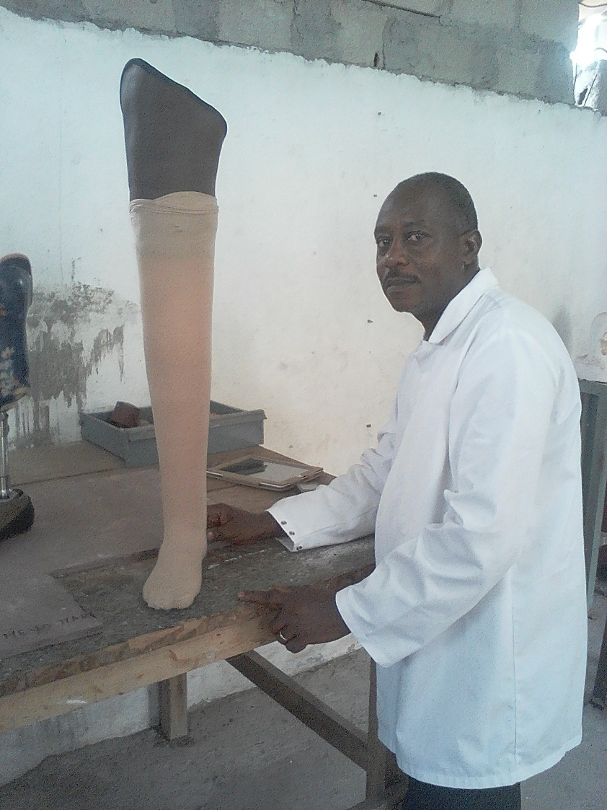
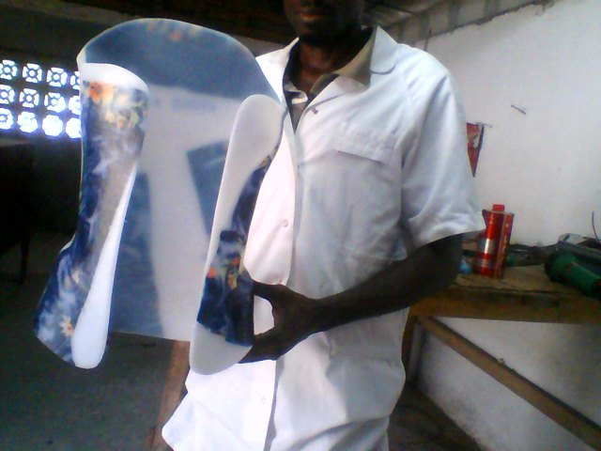
Results and testimonials videos and images

Slide 24
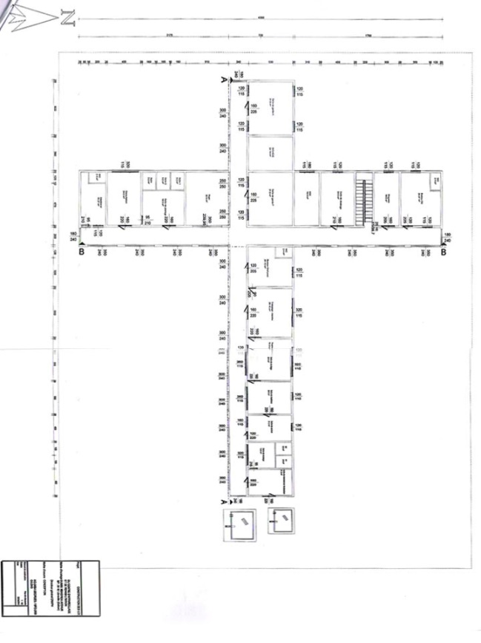
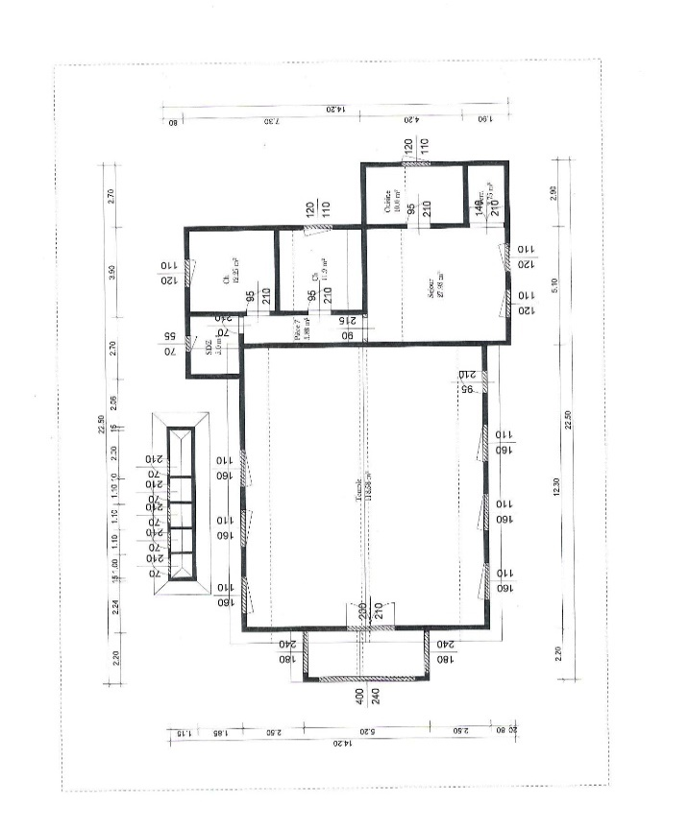
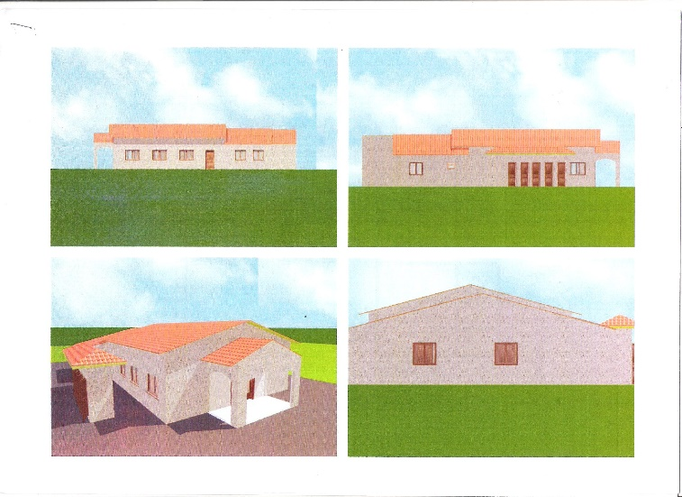
Project
Construction and Equipment of the Orthopedic centre and Training School in Gabon

Slide 25
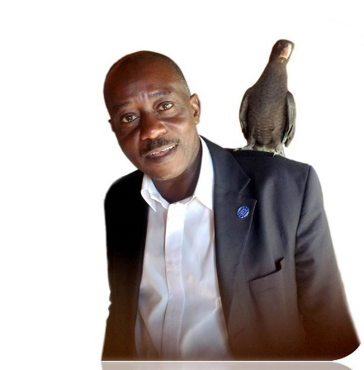
Conclusion
When you have the vision of something
You have a passion to realize thing
Diboti (Thank you)

