Slide 1
EXPERIENCE IN MANAGING THE UNIVERSITY CLINIC OF PHYSICAL AND REHABILITATION MEDICINE OF CNHU HKM DE COTONOU
Pr Toussaint G. KPADONOU
Head of the University Clinic of Physical Medicine – Rehabilitation
CNHU – HKM Cotonou

Slide 2
PLAN
INTRODUCTION
1. FRAMEWORK AND METHOD
2. RESULTS
3. DISCUSSION
CONCLUSION

Slide 3
Introduction1
Created in 1962 at the same time as the hospital "350 beds", the unit of masso-physiotherapy originally knew decades of stagnation before beginning its rehabilitation from 1991 thanks to Belgian cooperation.
After two decades and 1/2 of by step development, this unit will become today the University Clinic of Physical Medicine and Rehabilitation (CUPMR) of the National Hospital and University Centre Hubert K. Maga (CNHU-HKM).
CUPMR currently occupies a surface of almost 4000m2
CUMPR currently occupies an area of almost 4000m2
CUMPR is today a national and regional reference centre with three missions namely care, training and researches.

Slide 4
Introduction2
To assume this triple mission, it has an organization, including human resources, technical equipment adapted to sectorized services enabling to achieve each year products that make of CUMPR a model of service of CNHU-HKM Cotonou
Objective: Analyze the management experience of CNHU-HKM University Clinic of Physical Medicine and Rehabilitation

Slide 5
1. Framework and Method
1.1. University Clinic of Physical Medicine and Rehabilitation
The University Clinic of Physical Medicine and Rehabilitation (CUMPR) is one of 24 university clinics at the Hubert K. Maga National University Hospital Centre (CNHU-HKM)
CNHU HKM = first hospital and university centre of Benin.
  Establishment at the top of the health pyramid, located in Cotonou (economic capital of Benin)
  Serves as a national reference in all areas except respiratory and psychiatric diseases
  Endowed with an autonomy of management ensured by a management committee having at its head a Director General appointed by tne Council of Ministers,
  Gestion contrôlée par un conseil d’administration de 7 membres dirigé par le directeur du cabinet du ministre de la Santé A Management controlled by a board of Directors of 7 members led by the Director of the Office of the Minister of Health

Slide 6
1.1. University Clinic of Physical Medicine and Rehabilitation
1.1.1. Vision
Vision of the CUMPR Responsibles = offer quality services to every user
Vision desired by staff as a whole and expressed during EMP training
Vision also wanted by the management who wished to commit the CUMPR in the process of certification by 2021, CUMPR being the establishment which makes its pride

Slide 7
1.1.University Clinic of Physical Medicine and Rehabilitation
1.1.2. Mission
CUMPR has three missions:
Care Mission: Provide quality care to any patient in care at the CUMPR (in all areas of disability where it provides services
Teaching Mission:
  CUMPR Teaching mission:
  CUMPR provides practical training for undergraduate and masters students in physiotherapy at the” Ecole Supérieure de Physiothérapie (ESK)” of the Faculty of Health Sciences (FSS) of Cotonou, students of the Physiotherapy Schools of Belgium, France and of Canada and nursing students
  CUMPR provides training for 5th year medical students, DES PMR, Neurology and Pediatric Surgery and continuing education for doctors and physiotherapists (Benin and elsewhere)

Slide 8
1.1. University Clinic of Physical Medicine and Rehabilitation
1.1.2. Mission
CUMPR Has three missions:
Research Mission: Conduct research in all areas of health, environment, culture and society related to impairments, activity limitations and participation restrictions
  Publications
  Theses and dissertations directions

Slide 9
1.1. University Clinic of Physical Medicine and Rehabilitation
1.1.3. Organization
CUMPR has an organization chart composed of the head of the clinic, his deputy, the doctor in charge of hospitalization and the regulation of the care and the 4 supervisors (morning ambulatory care, afternoon ambulatory care, Hospitalization, and orthopedic fiiting)
The coordination usually meets every 15 days to discuss all the problems of the clinic and exceptionally on request as needed

Slide 10
1.1. University Clinic of Physical Medicine and Rehabilitation
1.1.3. Organization
1.1.3.1. Activity Sectors
CUMPR is divided into six activity sectors:
Sector of consultations and functional explorations which includes: medical consultations, electromyography, urodynamic assessment, infiltrations, stress tests and respiratory functional tests
Note that for problems of unavailable consumables the urodynamic assessment, the functional effort and respiratory tests knew a mitigated start
It is led by the Deputy Chief Doctor

Slide 11
1.1. University Clinic of Physical Medicine and Rehabilitation
1.1.3. Organization
1.1.3.1. Activity Sectors
CUMPR is divided into six activity sectors:
Physiotherapy Sector: the largest sector, consists of various physiotherapy areas
  pleviperineum physiotherapy, more and more attended
  Hand physiotherapy
  orthopedic / rheumatologic traumatic physiotherapy
  adult and pediatric neurological physiotherapy,
  posturology
  Stress training

Slide 12
1.1. University Clinic of Physical Medicine and Rehabilitation
1.1.3. Organization
1.1.3.1. Activity Sectors
CUMPR is divided into six activity sectors:
Orthopedic fitting dedicated to the manufacturing of orthoses ( trunk, thoracic and pelvic limbs), of prostheses ( pelvic and thoracic limbs) and technical aids
Speech Therapy dedicated to the assessment and management of communication disorders, language (written or spoken), swallowing

Slide 13
1.1. University Clinic of Physical Medicine and Rehabilitation
1.1.3. Organization
1.1.3.1. Activity Sectors
CUMPR is divided into six activity sectors:
Hospitalisation that includes twelve beds for all disabilities requiring intensive care for a faster recovery.
  To this sector is annexed a rehabilitation room including modern rehabilitation equipment (motomed and vestibular rehabilitation chair)
Acupuncture, the latest in the arsenal therapeutic, acupuncture was introduced less than 2 years ago to correct a lack of diversity in the care to patients.

Slide 14
1.1. University Clinic of Physical Medicine and Rehabilitation
1.1.4 . Space Occupation
CUPMR The CUPMR occupies a space of nearly 4000m2 distributed in Ground floor and 1st floor..
On the ground floor we find the reception, the waiting room, the 2 consultation rooms, the electromyography room, and the urodynamic assessment room.
  Each room houses the appropriate equipment, intended for its activity
  Separated from this sector is the large rehabilitation room compartmentalised into pools of musculoskeletal disorders physiotherapy, posturology, individual booths, central neurology (paraplegia, stroke, tetraplegia), balneotherapy, hospitalization with the conveniences of a 2-star hotel, Speech therapy and the annex of the hospitalization rehabilitation room.

Slide 15
1.1. University Clinic of Physical Medicine and
Rehabilitation
1.1.4 . Space Occupation
CUPMR occupies a space of nearly 4000m2 distributed in ground floor and a 1st floor.
Upstairs, there are areas of perinology, hand rehabilitation, pediatric physiotherapy, stress re-training, exercise and functional breathing tests, a physiotherapy room. of the musculoskeletal system, with pulley-therapy cages and individual cabins, two classrooms of which one is small and one larger (capacity of 100 students)
Orthopedic fitting is separated with the ground reserved for the reception, the waiting room, the measurement room (molding and casting) and that of the gait training and the 1st floor for the orthotic workshop , prostheses, shoes and assistive devices

Slide 16
1.1. University Clinic of Physical Medicine and Rehabilitation
1.1.5. Human Resources
CUMPR disposes of human resources of academic level and high competence that will enable it to fulfill its missions worthily
4 Doctors specialists in MPR 2 of which are magistral
22 Physiotherapists of whom 12 had their Master and 4 PhD
3 Orthopedic technologists
2 Speech therapists
6 nurses
2 Acupuncturists
2 secretaries
Caregivers (18)

Slide 17
1.1. University Clinic of Physical Medicine and Rehabilitation
1.1.6. Running
CUMPR operates according to the principle of participatory management
Every agent coming to the service knows that he has something to achieve before returning home without being the object of particular control
The number of patients per physiotherapist is known (12)
The number of students to supervise by each physiotherapist supervisor, each orthopedic technologists supervisor, each Speech therapist supervisor

Slide 18
1.1. University Clinic of Physical Medicine and Rehabilitation
1.1.6. Running
Two teams work in the physiotherapy sector (the 1st from 7h to 15h and the 2nd from 13h to 21h) as well as speech therapists
Any patient coming to the CUMPR is seen by a doctor who directs him either for explorations or for care,
In intramural hospitalisation, family meetings are held regularly => MPR team shares therapeutic project with the family of the hospitalized person
Monthly meetings of all service agents are held at the beginning of each month to review the activities of the past month and allows each agent to know his / her level of progress in the process, his / her performance

Slide 19
1.2. Method
This is a observational, cross-cutting, descriptive method that made it possible to determine the different productions made from January to September 2019.
Areas of exploration that have not been realized for at least 3 months have been excluded
The quantity of achievements is mentioned, but the quality must take into account other parameters that were not the subject of this study

Slide 20
2. Results
2.1.Point on care achievements
2.2. Point on training achievements
2.3. Point on research achievements

Slide 21
2.1. Care achievementson the CUMPR of CNHU-HKM de Cotonou (January to September 2019)

Slide 22
Table I : Medical activities conducted during the first three quarters of 2019
 | Medical Acts (n) |  |  | Doctor (n) |  | Average of consult./ working day
 | Consultations | Infiltrations | EMG
January | 358 | 10 | 20 | 4 |  |  | 17,04
February | 409 | 16 | 20 | 4 |  |  | 21
Marsch | 384 | 09 | 28 | 4 |  |  | 18,30
April | 444 | 07 | 44 | 4 |  |  | 21,14
May | 384 | 26 | 37 | 4 |  |  | 17,66
June | 378 | 05 | 36 | 4 |  |  | 21
July | 469 | 08 | 54 | 4 |  |  | 34,28
August | 442 | 06 | 34 | 4 |  |  | 21
September | 375 | 00 | 16 | 3 |  |  | 18
Total | 3.643 | 87 | 289 |  | 4 | 18,94

Slide 23
Table II : Revenues related to the activities of physicians during the first three quarters of 2019
 | Billed amount (F CFA) |  | Paid amount (F CFA)
January |  | 3.175.600 | 1.101.000
February |  | 2.866.400 | 989.900
March |  | 3.173.900 | 1.985.600
April |  | 4.249.700 | 564.460
May |  | 3.801.700 | 1.167.640
June |  | 2.939.300 | 1.238.580
July |  | 4.159.800 | 1.675.480
August |  | 3.303.500 | 1.532.760
September |  | 2.386.400 | 1.028.860
Total | 30.056.300 |  |  | 11.284.280

Slide 24
Table III : Activities in physiotherapy, speech therapy and ambulatory acupuncture during the first three quarters of 2019
 | Physiotherapy (n) |  |  |  | Speech therapy (n) |  | Acupu. (n)
 | Sessions performed | Physio | Sessions/Physio/working day |  | Assessment | Sessions | Sessions
January | 2.253 | 20 |  | 5,36 | 4 | 120 | 24
February | 2.365 | 18 |  | 7,88 | 4 | 85 | 19
March | 2.378 | 16 |  | 8,28 | 3 | 65 | 39
April | 2.682 | 15 |  | 9,10 | 9 | 150 | 96
May | 2.560 | 15 |  | 8,18 | 5 | 125 | 86
Juine | 2.152 | 14 |  | 9,61 | 8 | 190 | 98
July | 2.442 | 13 |  | 9,78 | 17 | 265 | 86
August | 2.511 | 15 |  | 8,13 | 22 | 445 | 118
September | 1.876 | 10 |  | 10,64 | 11 | 255 | 8
Total | 21.219 | 15 |  | 8,55 | 83 | 1.700 | 574

Slide 25
Table IV : Revenue related to physiotherapy, speech therapy and ambulatory acupuncture activities during the first three quarters of 2019
Billed amount (F CFA) |  | Paid amount (F CFA
14.931.000 | 3.580.300
15.827.200 | 3.213.800
16.408.400 | 4.057.180
16.936.100 | 2.208.520
18.429.400 | 5.224.080
13.988.000 | 5.457.700
16.237.500 | 5.033.660
14.169.600 | 5.011.160
16.458.800 | 3.794.720
143.386.000 | 37.581.120

Slide 26
Tableau V : Intra-mural hospitalization activities during the first three quarters of 2019
 |  | Physiotherapy (n) | Speech therapy (n) |  |  | Stay (n)
 |  | Sessions performed | Assessment | Sessions |  | Hosp. day | Patients
January |  | 197 | - | 40 |  | 146 | 8
February |  | 253 | - | 45 |  | 172 | 8
March |  | 187 | 1 | 20 |  | 143 | 10
April |  | 322 | 3 | 60 |  | 247 | 11
May |  | 214 | 1 | 30 |  | 160 | 13
June |  | 215 | - | 5 |  | 164 | 8
July |  | 215 | 4 | 59 |  | 182 | 11
August |  | 248 | 1 | 60 |  | 277 | 11
September |  | 182 | 2 | 40 |  | 258 | 11
Total | 2.033 |  | 12 |  | 359 | 1.749 | 91

Slide 27
Table VI : Revenue for intramural hospitalization during the first three quarters of 2019
 |  | Billed amount (F CFA) | Paid amount(FCFA)
January |  | 4.972.700 | 590.540
February |  | 4.419.000 | 1.037.100
March |  | 4.483.900 | 827.980
April |  | 5.908.100 | 1.839.760
May |  | 4.631.000 | 1.659.180
June |  | 4.229.000 | 733.400
July |  | 5.236.700 | 1.204.800
August |  | 6.497.900 | 2.204.800
September |  | 4.977.000 | 2.623.160
TOTAL | 45.355.300 |  | 12.720.720

Slide 28
Table VII : Financial revenues and activities of orthopedic fitting
 | Protheses (n) | Orthoses (n) | Podiatry (n) | Others (n) | Paid amount CFA)
January | 1 | 24 | 17 | - | 1.800.300
February | 2 | 16 | 21 | 1 | 3.110.175
March | - | 16 | 17 | 1 | 1.458.500
April | - | 21 | 22 | - | 1.065.000
May | 2 | 16 | 14 | 1 | 2.420500
June | - | 12 | 14 | 1 | 1.035.000
July | 1 | 14 | 17 | 1 | 1.238.420
August | 3 | 18 | 38 | 1 | 3.437.850
September | 2 | 21 | 19 | 1 | 1.794.450
Total | 11 | 158 | 79 | 7 | 17.360.195

Slide 29
Table VIII: summary of CUMPR activities from January to September 2019
 | Number | Observations
Medical Consultations | 3.643
Infiltrations | 87
Electromyography | 289
Sessions of physio performed | 23.252
Speech therapy performed | 2059
Speech therapy assessment performed | 95
Acupunture sessions performed | 574
Hospitalisation day performed | 1749
Orthopedic devices achieved | 255 | Including 158 orthoses and 11 protheses

Slide 30
Table IX : Point of CUMPR financial revenue from January to September 2019 according to activities
 | Billed amount (F CFA) | Paid amount (FCFA)
Medical activities | 30.056.300 | 11.284.280
Outpatient rehabilitation | 143.386.000 | 37.581.120
Intramural Hospitalisation | 45.355.300 | 12.720.720
Orthopedic fitting | 17.360.195 | -
TOTAL | 236.157.795 | 61.586.120

Slide 31
Table X : Different types of pathologies encountered at CUMPR during the first three quarters of 2019
 | Number | %
Spinal diseases | 1185 | 52,01
Arthroses | 125 | 5,47
PAdult neurological pathologies | 407 including 182 Stroke case | 42,98
Bone and soft tissue damages | 191 | 8,36
Amputations (protheses) | 16 | 0,70
Child neurological patholigies (Cerebral palsy ) | 88 | 3,85
Perineology | 102 | 4,46
Lymphœdma | 16 | 0,70
Orthopedic deformities | 69 | 3,02
Pulmonary Pathologies | 45 | 1,97
Skin lesions (burn) | 07 | 0,3
Others | 33 | 1,44
Total | 2.284 | 100

Slide 32
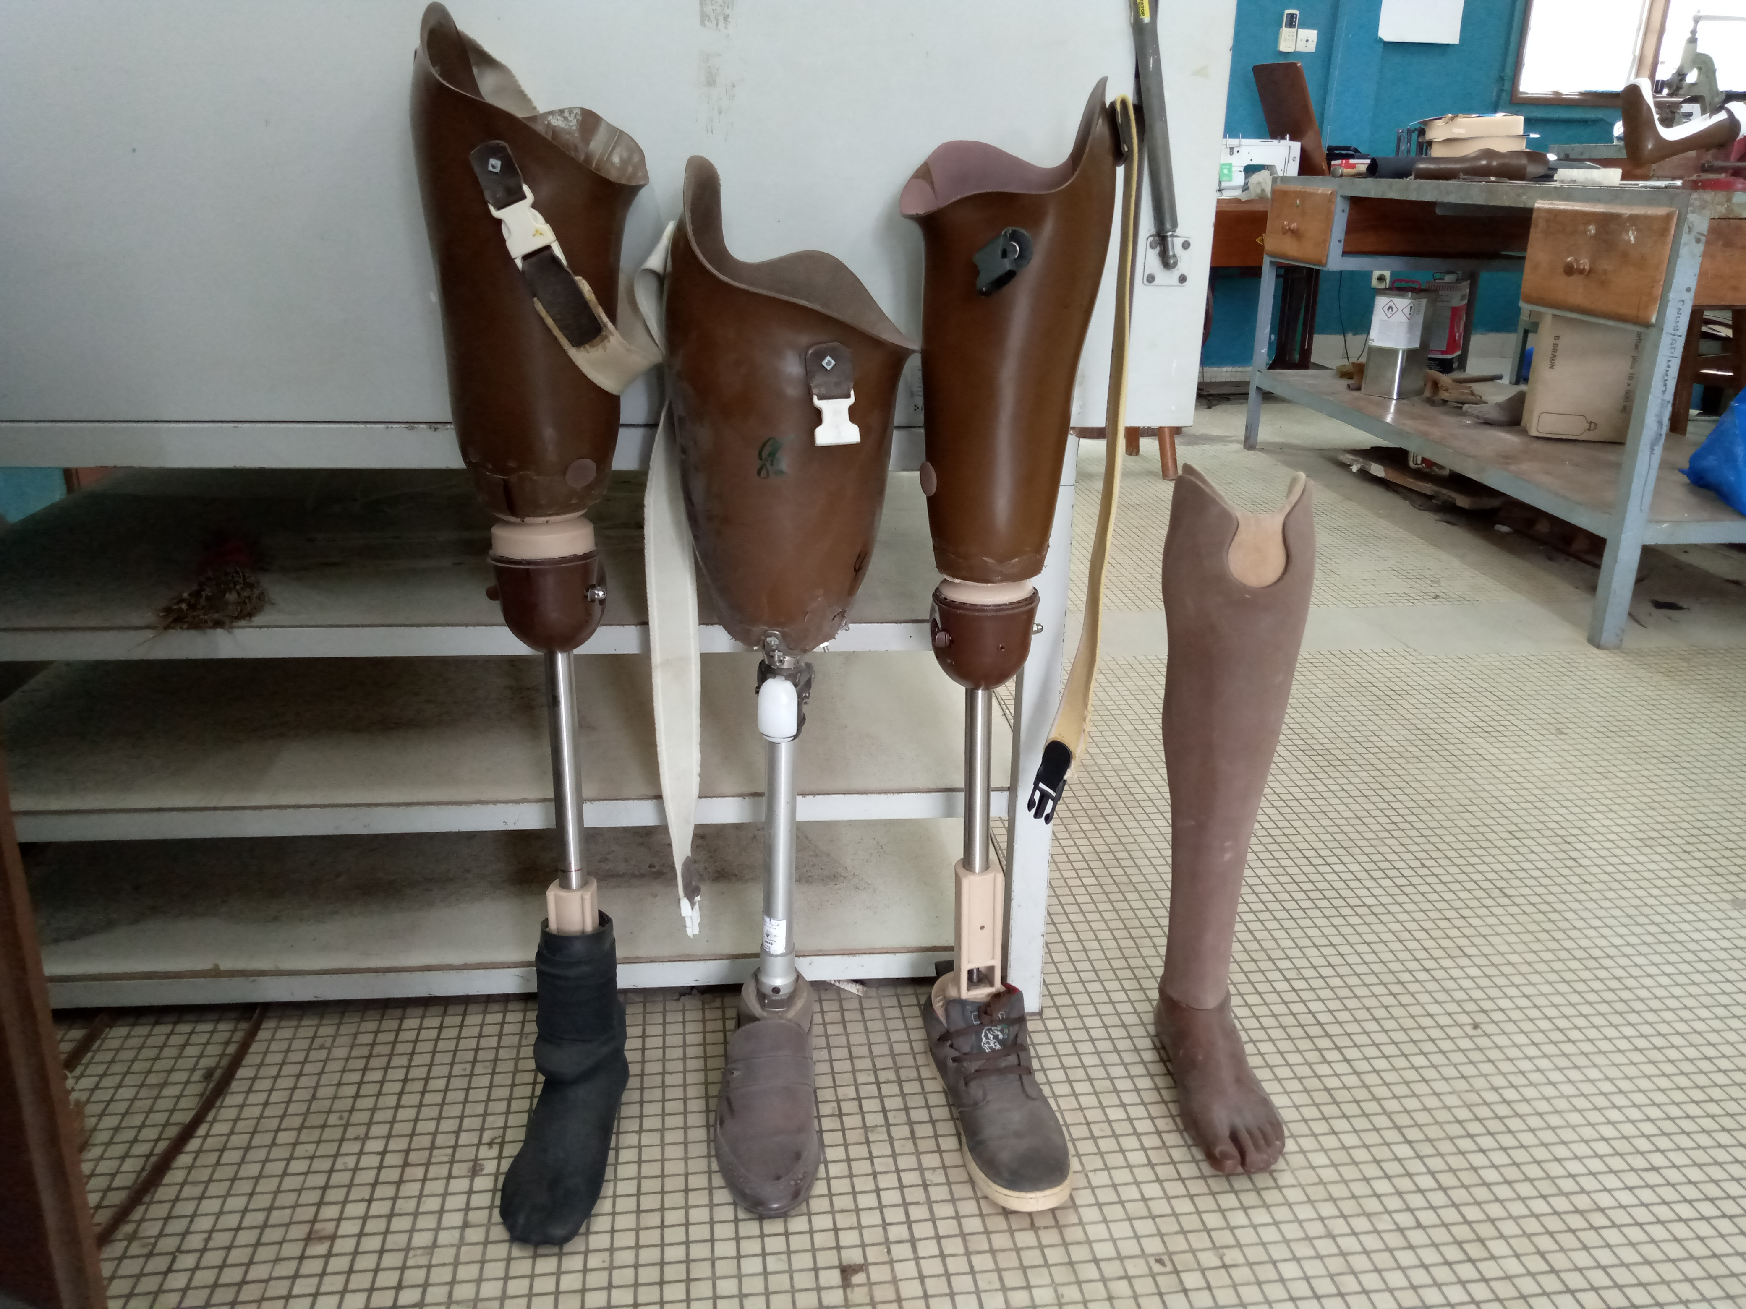
Some achieved prostheses

Slide 33
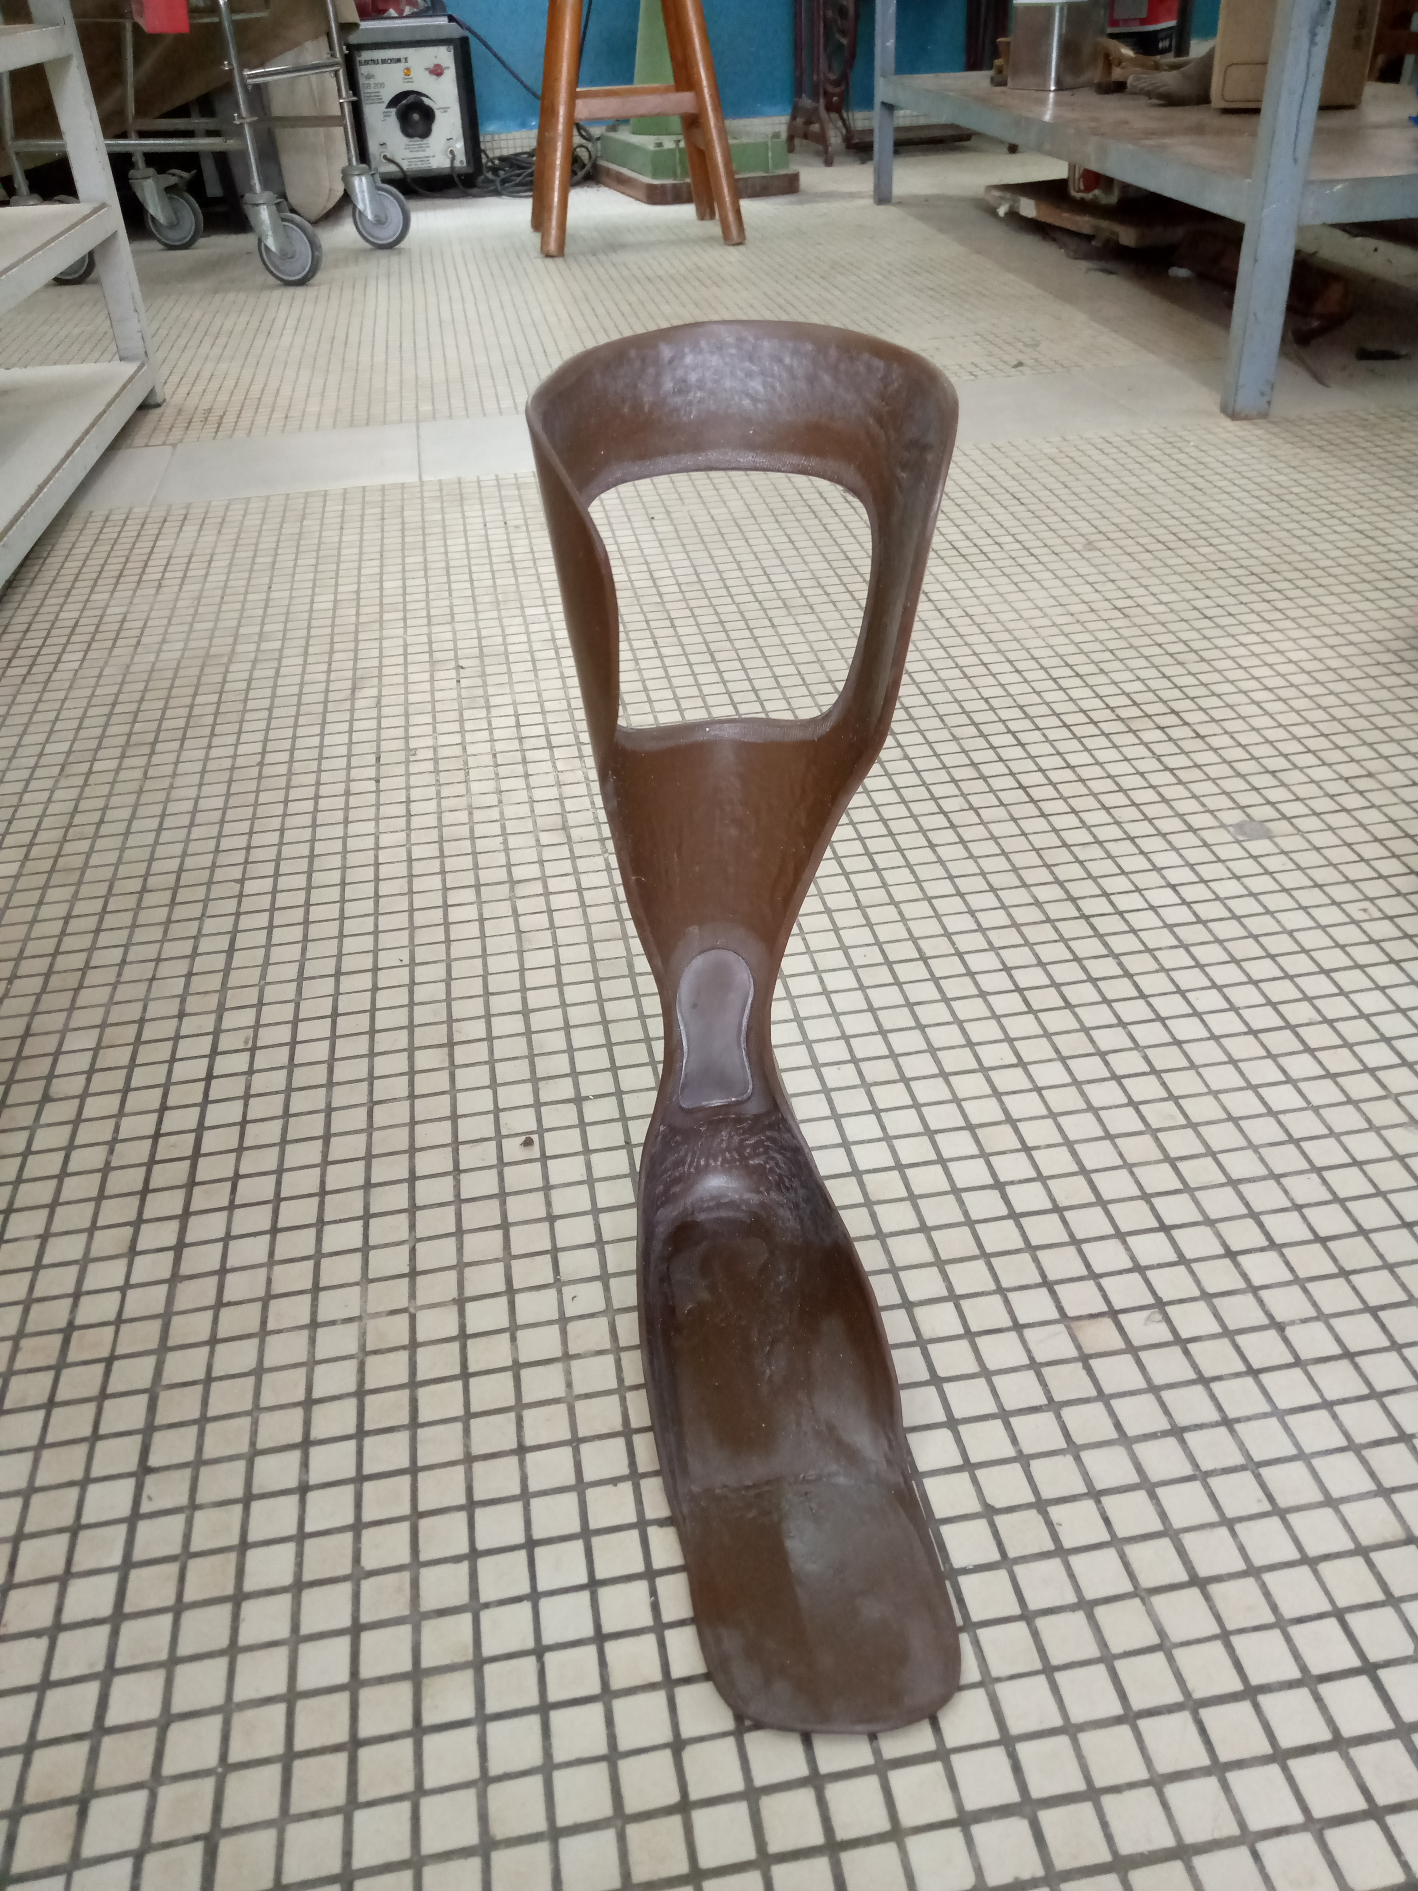
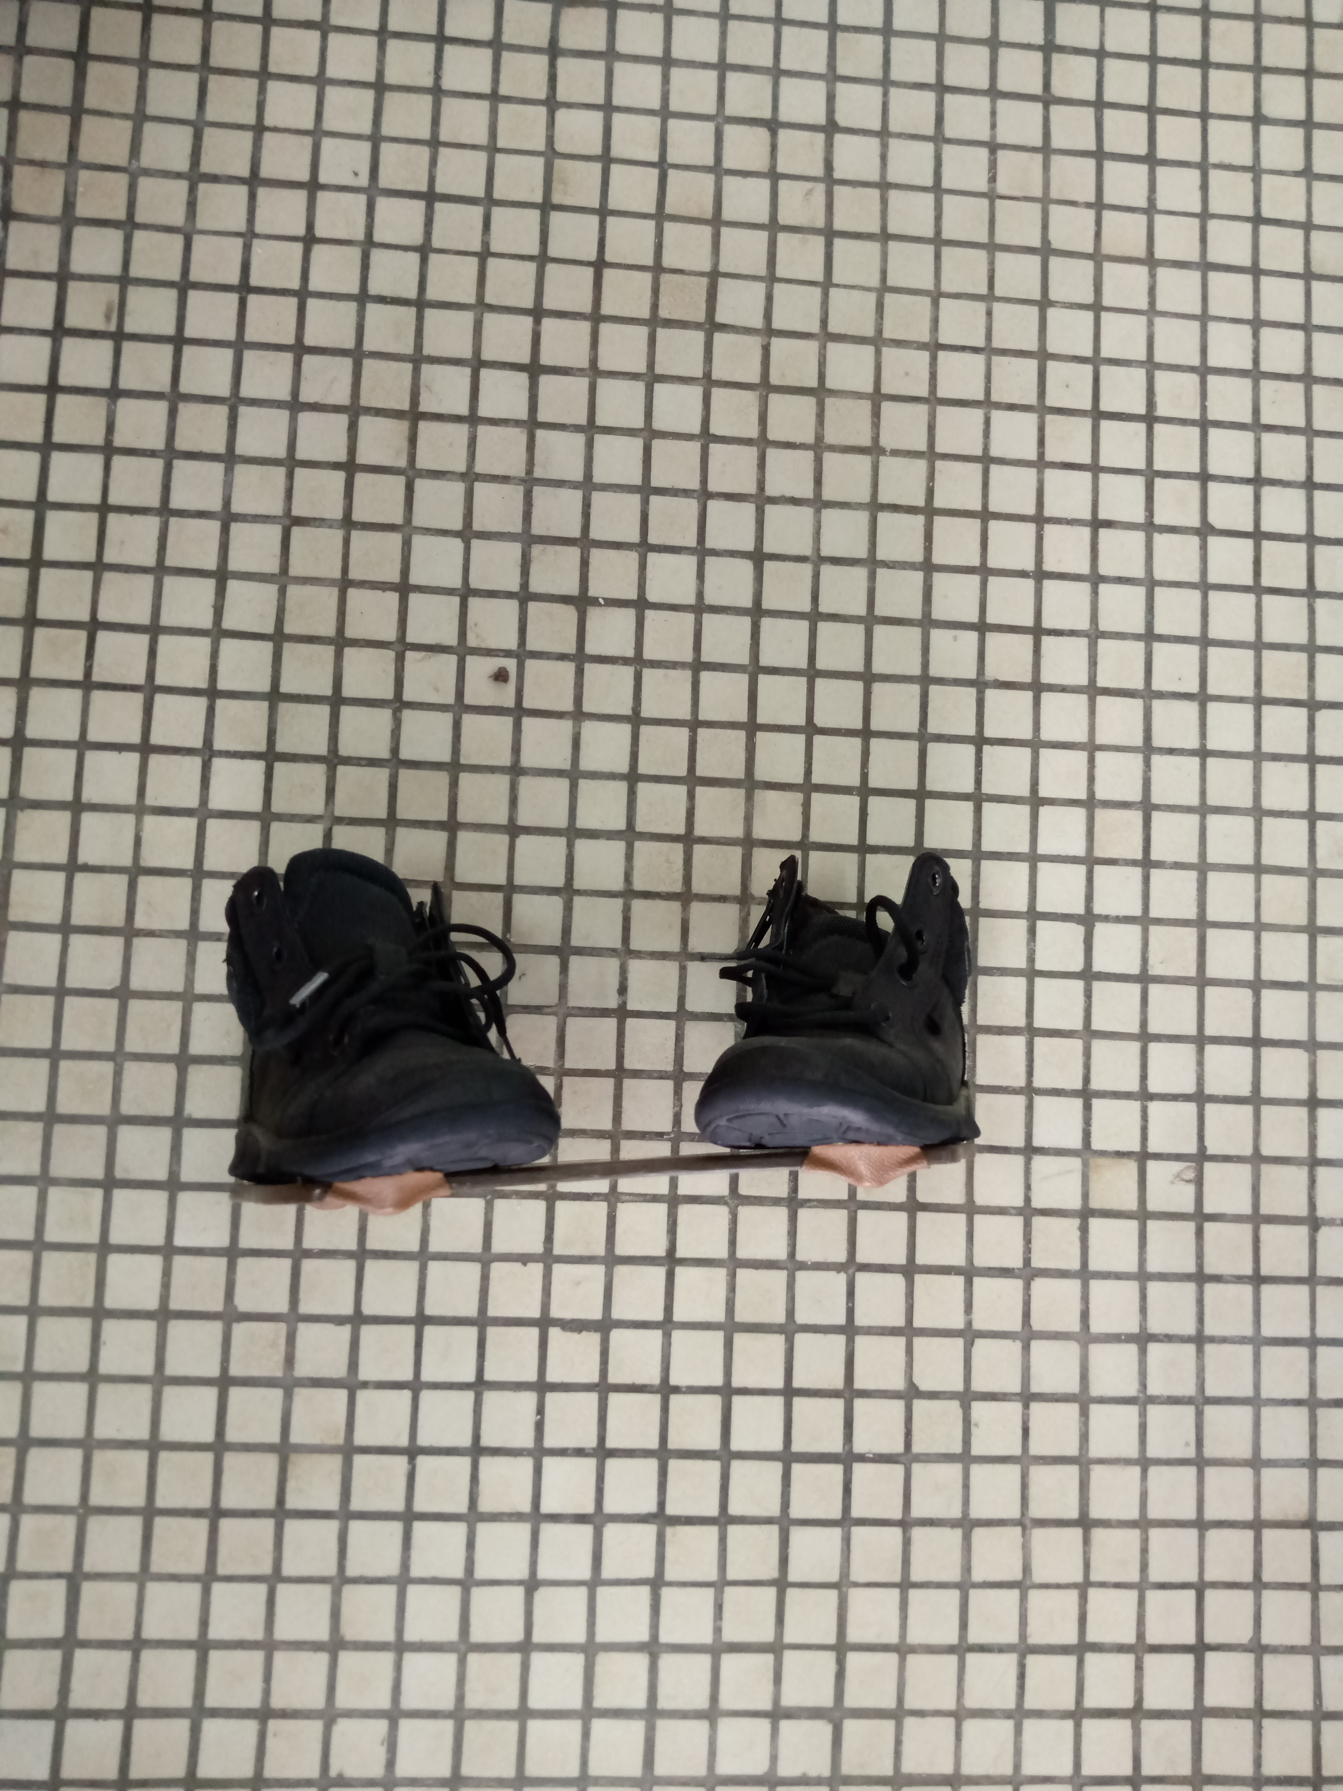
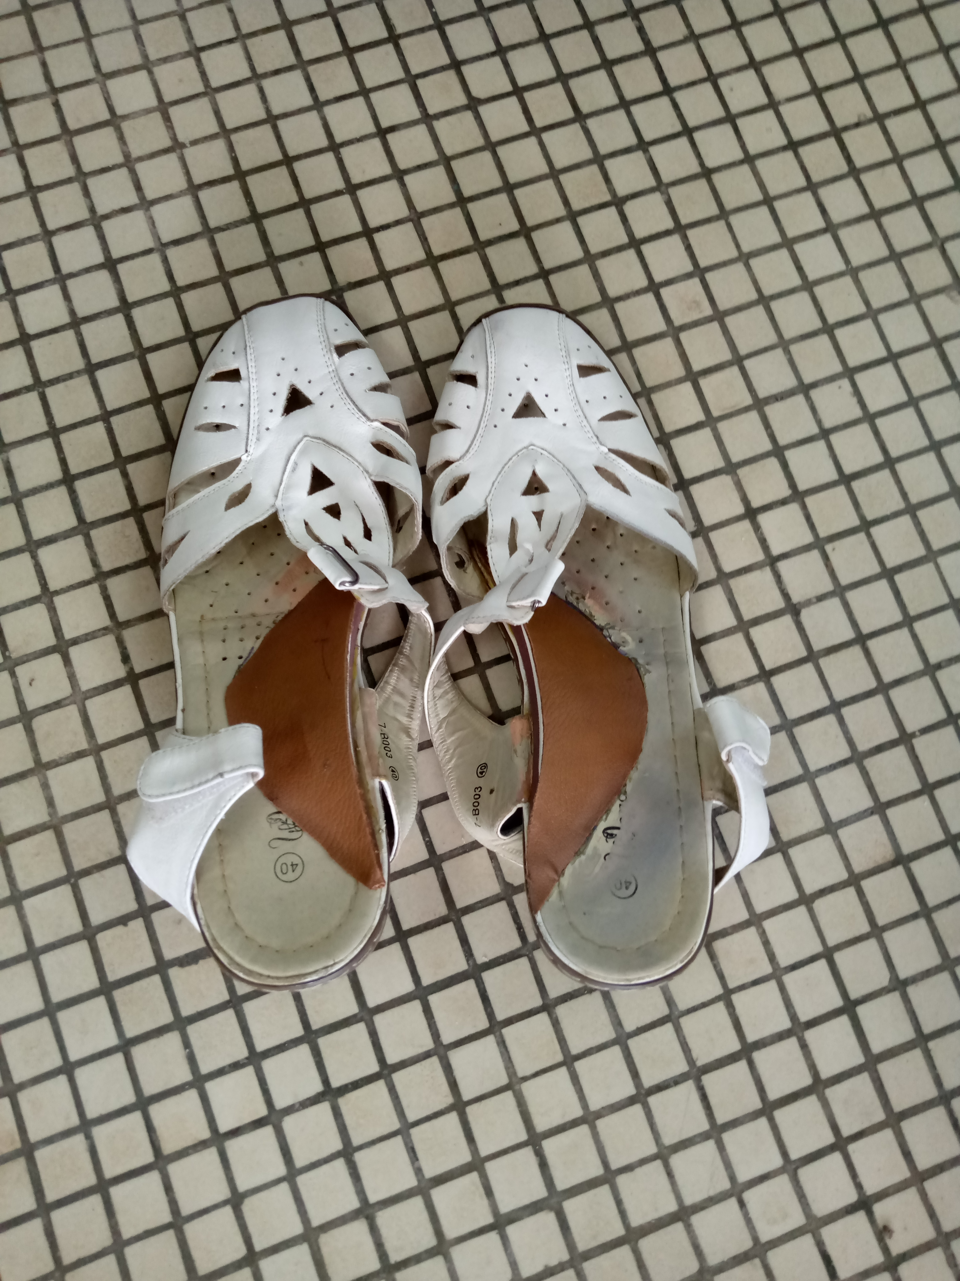
Dennis Brown’s shoes, lifter and splint

Slide 34
2.2. Teaching achievements at CUMPR from January to September 2019

Slide 35
2.2. Training/Teaching
24 students from the High School of physiotherapy benefitted from teaching
6 Belgian strudents in physiotherapy are in training at CUMPR
3 French students did their practical training
12 nursing students at INMEs
150 5th year medical students
6 DES in PMR
3 DES in pediatric surgery
2 DES in Neurology
Physiotherapists and general practitioners in continuing training

Slide 36
2.3. Research achievements

Slide 37
2.3. Research achievements
12 physio licenses Memoirs
4 physiotherapy Master Memoirs
4 PhD Theses
4 published articles
12 communications

Slide 38
3. Discussion
3.1. Care achievements
3.2. Teaching achievements
3.3. Research achievements

Slide 39
3.1. Care achievements
The means at CUMPR are very diversified and of two types:
  Assessment means
  Therapeutic means
3.1.1. Assessment means
They are numerous and sophisticated allowing the advanced diagnostics in a modern PRM service, having nothing to envy to the centres of the north.
  hey make it possible to explore various types of neuromuscular, urogynecological and cardiorespiratory deficiencies….
  The only problem common to sub-Saharan hospital structures: regular supply of consumables.
  Bringing back thus the thorny issue of CUMPR's autonomous financial management (all the revenues go into the common fund to support other deficit clinics)

Slide 40
3.1. Care achievements
Means at CUMPR are very diversified and of two types:
  Assessment means
  Therapeutic means
3.1.2. Therapeutic means
They are also various diverse and sophisticated, allowing the management of all kinds of neurological, muscular, traumatic, rheumatologic, urogynecological, respiratory deficiencies ... all the field covered by the PMR as a whole.
However, two therapeutic means are lacking (Occupational Therapy and Cardiac Rehabilitation)

Slide 41
3.1. Care achievements
Means at CUMPR are very diversified and of two types:
Assessment means
Therapeutic means
3.1.3. Achievements of the first 3 quarters
They are important both in their workforce and in the generated revenue enabling CUMPR to be one of the locomotives of CNHU HKM.
Monthly revenues are on average 22 million CFA
Let us note, however, the big gap between the billed revenues and the collected revenues (problem of payment of care in developing countries!)

Slide 42
3.2. Teaching achievements
Learners supervised within the CUPMR are of several levels and specialties
This reflects the quality of the human resources that work there
The start of the DES PMR for 3 years gives an illustration and allows to have every day a presence of learner in the clinic
The presence of Belgian, French and Canadian students gives it an international dimension.

Slide 43
3.3. Research achievements
Scientific productions, though minimal, testify the research vitality
It is certain that with the end of the academic year, scientific productions will increase thanks to the grouped theses and memoirs defenses organized by the FHS

Slide 44
Conclusion
CUMPR Cotonou is a modern rehabilitation service with high-level assessment and therapeutic resources
It has a structured organization, a vision and shared missions, and competent and diversified human resources enabling it to be risen at the level of excellence in rehabilitation in the sub-Saharan region.
However there is a lack of some rehabilitation professionals in the rehabilitation team
Nevertheless, the objective of certification by 2021 shared by the management of the CNHU as well as by the staff of the clinic, allows to keep hope that problems that prevent its full development will be solved.

Slide 45
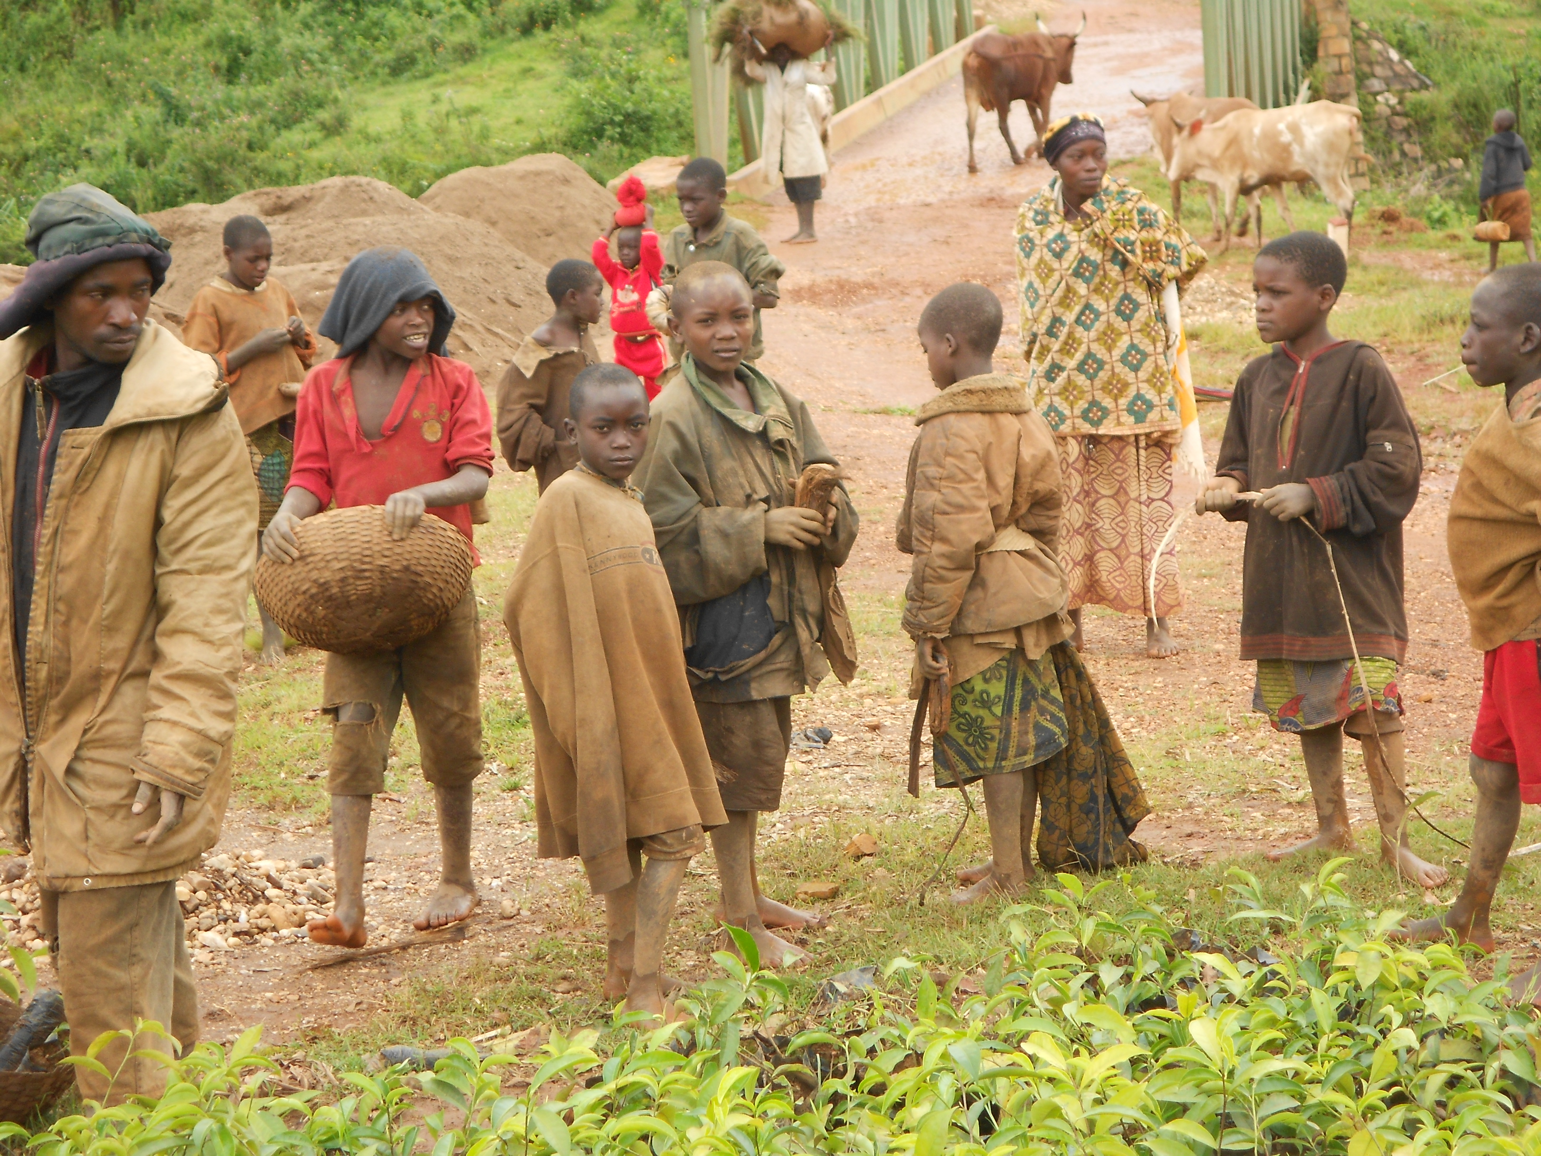
THANK YOU FOR YOUR attention

