Slide 1

Reflexion and training strategic Seminar for Managers and professionals of Physical Rehabilitation centres
The Orthopedic fitting Centre
Presentation & Perspective
Ms Monia MRAD
Manager of the Centre

Slide 2
Contents
Introduction: presentation of CAO
Production in CAO
Training and upgrading
Impeovement of the performance of CAO
1
2
3
4

Slide 3
Presentation of the Orthopedic Fitting Centre
Created in 1970 by the Finance Act N ° 66/70 of 31/12/1970
Integrated to the CNSS by the finance law N ° 29/95 on February 27, 1995
Contribution to the orthopedic fitting prescription
Rehabilitation of People with disabilities and victims of accident for their insertion in socio-professional life
Manufacture and repair of orthopedic devices
Assignment of the Centre
Continuing education of students and technologists
Studies and research in orthopedics field
Notes:
3

Slide 4

Presentation of the orthopedic fitting Centre
Ariana
Tunis
Bizerte
Manouba
Jendouba
Béja
Nabeul
Is composed of one central unit located in Tunis and two regional units in Sousse, Sfax, Kairouan et Nabeul
Zaghouan
Le Kef
Siliana
Kasserine
Kairouan
Mahdia
Sidi Bouzid
Sfax
Gafsa
Touze
Gabes
Regions covered by the centre of Tunis
Kébili
Médenine
Regions covered by URAO Sousse
Regions covered by URAO Kairouan
Tataouine
Regions covered by URAO Sfax
Regions covered by URAO Nabeul

Slide 5
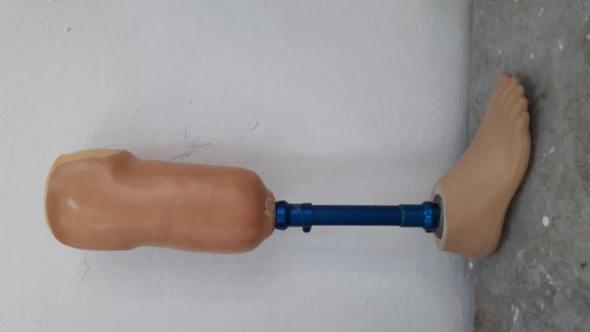
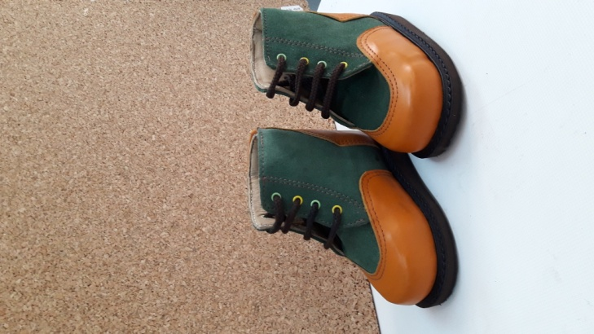
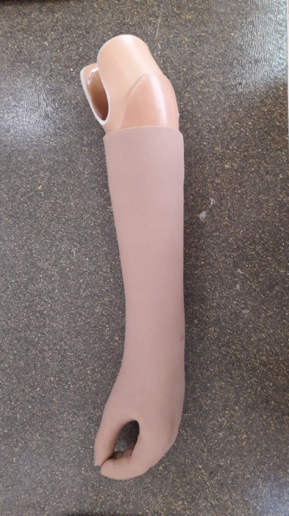
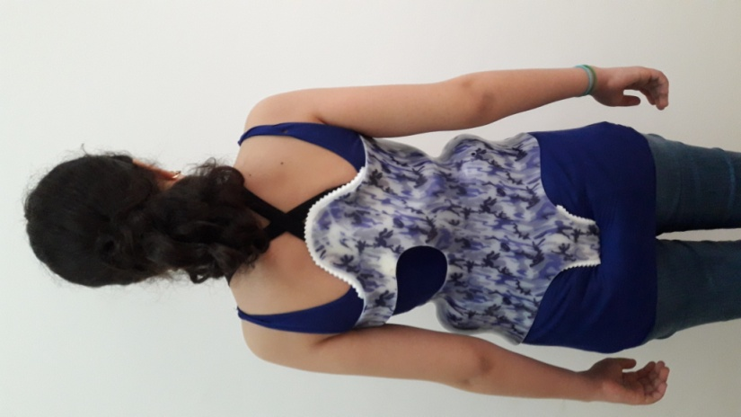
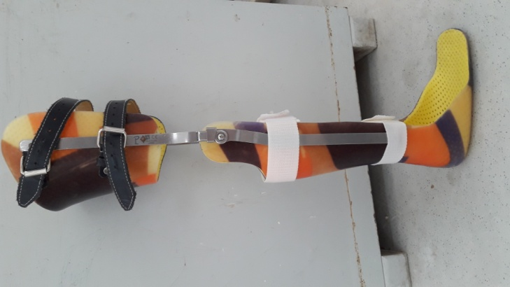
Presentation of the Orthopéedic Fitting Centre
Specialities in the centre
Upper Limb Prostheses
Lower Limb Prostheses
Lower and upper limb orthoses
Saddlery and Bandage
Podo-Orthesis
Trunk Orthosis

Slide 6

Presentation of Orthopedic Fitting Centre
Beneficiairies of the devices
CAO
Insured persons affiliated to CNAM
Holders of free care cards
Payers ( cash)
Private insurances

Slide 7
Presentation of the Orthopedic Fitting Centre
Distribution of beneficiaries by care organization

Slide 8
Presentation of the Orthopedic Fitting Centre
Human Resources at the centre and regional units régionales
The number of staff amounts to 125 agents shared as follows:

Slide 9
Production process of the fitting
Production
Patient assessment and prescription of the fitting code
Deposit of the file at the Centre desk
Casting and footprint taking
Manufac ture of the device
Trial
Delivery of the device

Slide 10
Production
Statistics and deliveries
Number of deliveries at the centre and regional units

Slide 11
Number of delivery per type of devices and per centre and appendices
Production
Statistics of deliveries

Slide 12
Number of deliveries per type of device
Production
Statistics of deliveries

Slide 13
Continuing education for technologists
Fitting Consultations d’appareillage
In the framework of a positive interaction between doctors and technologists in order to guarantee the maximum efficiency of the patients' diagnosis and to choose the most appropriate device for their situations, technologists go to hospitals to take part in the consultations.
Regional Nabeul
Regional Kasserine
Regional Mahdia
Regional Sousse
Regional Béja
M Kassab in Tunis
La Rabta in Tunis
Regional in Sfax
Regional Gabes
Regional B. Gardanne
Regional Gafsa
Hospitals

Slide 14
Internships
Continuing education for Technologists
The centre welcomes every year students doing different speialities
Specialities
Orthopedic fitting
Physiotherapy
Podology
Leather and shoes
Institutions
High School of Health Sciences and Techniques of Tunis
High School of Health Sciences and Techniques of Sousse
High Institute of Technological Studies
Vocational Training Center Ariana
Vocational Rehabilitation Centre

Slide 15
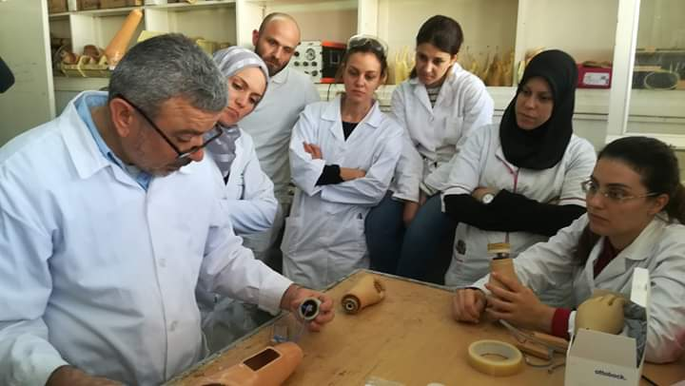
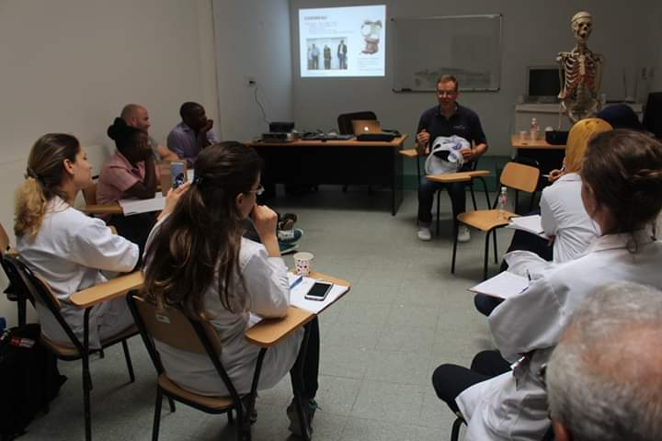
Fairs and workshops
Continuing education for technologists
WOrKSHOP 1
April 2018
Evolution of trunk orthoses manufacturing technique
Workshop 2
November 2018
New techniques for manufacturing upper limb prostheses
International fair
OTWORLD May 2018 in Germany
Follow the evolution of orthopedic fitting techniques

Slide 16
The Tunisian-German Agreement
Continuing education for technologists
SEQUA
National Social Security Fund
Objectives of the project
Training of qualified technologists
Phase 2
2016-2018
ISPO Cat 2 Training
17
ISPO Cat 1Training
4
Phase 1
2013-2015
ISPO Cat 2 Training
26
Formation « PODO »
10

Slide 17
Formation continue des techniciens
Le comité de pilotage
Un comité de pilotage a été constitué au cours de la deuxième phase du projet
Mise à niveau du secteur de l’orthopédie en Tunisie
Travaux du comité
Elaboration du cahier des charges établissant le cadre juridique pour l’exercice de la profession
Elaboration du référentielle du formation et de métiers
Redémarrage de la filière orthopédique parmi les spécialités de l’école de santé à partir de 2017
Organismes participants
Ministère de la santé publique
Ministère de l’éducation supérieure et des recherches scientifiques
Ministère de la formation professionnelle et de l’emploi
Caisse Nationale de Sécurité Sociale
Caisse Nationale d’Assurance Maladie
Etablissement Human Study
Institut de Valence - France

Slide 18
Strategy
Agree with the National Strategy:
A multidisciplinary team has been appointed to develop the centre's strategic plan
Visions
Diagnosis
Objectives
Action Plan

Slide 19
Strategy
Visions
1
2
Make the centre a reference for evaluation and consultation
3
To encourage and develop the role of the center to be a national or even international reference in the field of technical training.
Ensure the compliance of the device delivered and the service provided with international standards in the field

Slide 20
Strategy
Diagnosis
Identification and setting up of processes
Processus
Identification and analysis of stakeholders
Interaction
Process Risk Analysis
Risque
Legal and other requirements
Conformité

Slide 21
Results: Objectives and Action plan
Strategy
Training on the new techniques on trunk orthoses and lower limb orthoses by holders of CAT1 Diploma
Définir les points à réviser au niveau de la nomenclature (prices articles)
Identify the profiles required for the MAJ of the nomenclature
Appoint the members of the committee in charge of the MAJ of the nomenclature
Preparation of a law project to derogate CAO from public procurement procedures
Recruit staff with international CAT1 diploma in teaching LAP students at the School of health.
Nominate internship tutors to coach trainees
Ensuring a quality workforce in the coming years.
Reducee constraints resulting from public contracts
Exchange of technical knowledge
Update the orthopedic fitting nomenclature

Slide 22
Conclusion
Because the orthopaedic fitting field is playing an important role in the social equilibrium: CAO becomes the center of interest as a public organization and a key structure in this field, through the fitting that it continues to offer to people with disabilities and accident victims for their insertion in the socio-professional life.

Slide 23



Thank you for your Attention

